Slide 1
Soil
The importance of Soil and why we should care more about the wonderful world beneath our feet.

Slide 2
So, we’re all familiar with Soil, but what IS soil?
Soil might seem simple, but it’s not just dirt! Soil is a complex mixture of mineral particles, organic matter, water, air, and living organisms.
Mineral Particles: soil is made up of eroded rock, and sediments
Organic Matter: the decay of organic matter adds key nutrients to the soil
Living Organisms: you can find up to 1.5kg of living organisms beneath one square metre of healthy soil; both macro and micro organisms inhabit soils
Water: water is a key component of soils and greatly affects soil properties, as well as the water cycle
Air: the porosity of soil (amount of pore space between particles) affects the properties of the soil such as density and structure
Notes:
Mineral particles: soil can have many different ‘parent materials’ which is what we call the source rock or sediments that make up a soil. For example, soil can have a parent material that is the bedrock on which it overlies, as this bedrock is weathered chemically and physically, fragments can break off and become a part of the soil as well as ions being release through chemical degradation. Mineral particles can also come from other forms of parent material such as Volcanic ash and erupted material such as in Andisols (volcanic soils)
Organic matter: as plants and animals die or produce waste, this is recycled into the soil through decomposition, this is done by decomposers such as fungi, bacteria, and Detritivores like worms and millipedes. This leads on to another key component of soils, living organisms. 1.5kg organisms source: University of Manchester: https://www.manchester.ac.uk/discover/news/why-soil-matters-more-to-life-than-we-realise/#:~:text=Up%20to%201.5%20kilograms%20of,%2C%20fungi%2C%20and%20many%20more.
Living Organisms: organisms contribute to soil structure though the formation of tunnels and burrows e.g. Worms, Moles. Microorganims esp. imp. With biochemical processes such as chemical weathering of rock releasing ions and nutrients into soil, decay/decomp, nitrogen cycle.
Water and Air: the space between soil particles is filled with air or water and is known as porosity; water and air content affect soil properties like density, structure

Slide 3
Layers in Soil
O Horizon- this is usually a thin layer of organic matter
A Horizon- is a layer rich in nutrients and organic matter
B Horizon- this is older soil that is in contact with the bedrock and is rich in minerals
C Horizon- the bedrock which acts as the parent material, as it is eroded it supplies minerals to the soil above
O Horizon
A Horizon
B Horizon
C Horizon Bedrock
Notes:
There are different layers in different types of soil depending on the location at which they form, and their maturity. But, we generally describe soils as having O,A,B,and C horizons.
The first horizon is known as the O horizon which is typically a thin layer of organic matter, such as plant debris that is being decomposed into the soil; this layer is normally a darker colour than others
A horizon is the first true layer of matured soil. This horizon is typically rich in organic matter, which comes from sources like decomposed plants/other organic matter.
Function: This layer is where plants uptake most of their nutrients with their roots
B horizon is more matured and often contains minerals from the C horizon and some nutrients that have moved down from the A horizon over time.
Function: This layer acts like a storage area for minerals and nutrients that have been leached down from above or from the C horizon
C horizon is the parental bedrock itself which is weathered, made of rock or unbroken material that hasn't turned into soil yet.
Function: This is where soil begins. Over time, weathering breaks down the C horizon into the B and A horizons.

Slide 4
Types of Soil
Clay
100%
Soils are classified based on their properties including:
Texture- using the proportion of clay, sand, and silt
Colour- this is done using a Munsell chart
Water content
% Clay
% Silt
Sandy clay
Silty clay
Loam
Sand
100%
% Sand
Silt
100%

Slide 5
Formation of Soil
Microbial decay of organic matter
Soil is formed from the weathering of rocks and the decomposition of organic matter; this is an ongoing process that happens over a long period of time
Many different factors influence soil formation such as the ‘CLORPT’ factors:
Climate- this will affect the water content of the soil, and how much the soil is dried by the sun
Organisms- contributes to soil fertility by providing nutrients, improving soil structure, and enhancing the soil's water-holding capacity
Relief/Topography- steeper topography will increase surface runoff of water, flatter will encourage water to remain on the surface
Parent material- this influences the minerals and chemical composition of the soil
Time- a more mature soil will have taken a longer amount of time to form and should have more developed horizons and features
Organisms’ presence
Weathering of bedrock

Slide 6
We’re treating soil like dirt. It’s a fatal mistake, as our lives depend on it- Monbiot
Soil is everywhere!
Soil is arguably the first part of the terrestrial food web, as life has relied on soil since the very first plants became terrestrial
As a result, humans have had a reliance on soil from the start, a text from 1500BC reads:
“Upon this handful of soil our survival depends. Husband it and it will grow our food, our fuel and our shelter and surround us with beauty. Abuse it and the soil will collapse and die, taking humanity with it.”
We have all known the importance of soil for centuries, so why have we been taking it for granted?

Slide 7
Aggressive Agriculture
Heavy machinery
Chemical pesticides and fertilisers
Overirrigation
Tilling
Monoculture
Due to increased demand for food security with our ever-growing population, often we value productivity and crop yield over soil conservation and sustainability

Slide 8
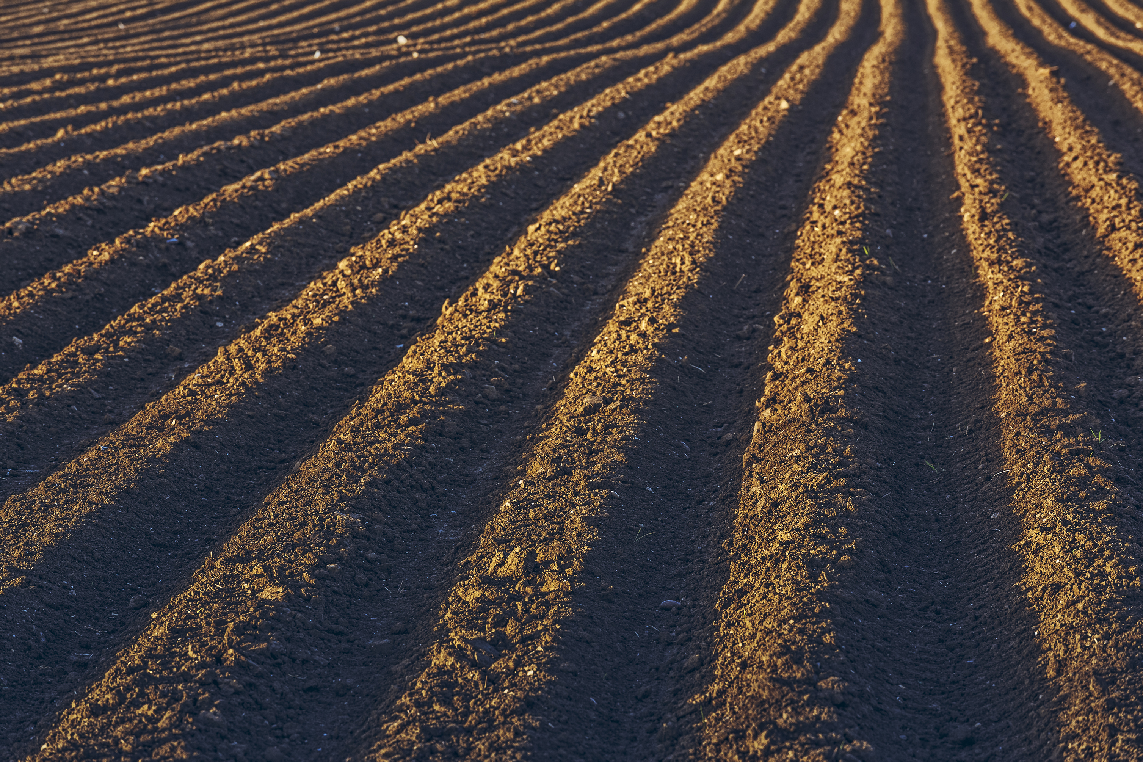
Heavy Machinery
Compaction
When machines such as large tractors are driven over soil, they compact the soil
This causes the pore space to be reduced, inhibiting water infiltration and growth of roots
Excessive Tilling
The process of ploughing and tilling disrupts the soil structure and leads to erosion of topsoil
This leads to reduced porosity and decreased fertility
Stock image sourced from Microsoft 365 content library

Slide 9
Chemical Pesticides and Fertilisers
Pesticides
Fertilisers
Pesticides are used to kill pests on and around crops such as insects, fungi, and weeds, which may harm crops
The problem with pesticides is that they often kill helpful micro and macro organisms which can harm the soil ecosystems and lead to a decrease in soil fertility
Chemical fertilisers are used to increase crop yields by supplying more nutrients to plants
This can disrupt the chemical balance of the soil, leading to acidification and harming organisms in the soil
Fertiliser use further impacts ecosystems when it is transported into waterways leading to algal blooms in a processed called Eutrophication

Slide 10
Overirrigation
Wastes water- economic and environmental loss
Creates anoxic environment- pore space is filled with water
Leads to rot- roots cannot get the nutrients they need so decay, encourages growth of harmful fungi and bacteria
Leaches nutrients from soil, and
Increases erosion; the excess water runoff will carry nutrients and soil particles away from the land decreasing fertility and structure.
Overirrigation is an issue that occurs when farmland is oversaturated with water which leads to pore space within the soil being filled with water.

Slide 11
Monoculture
The agricultural practise where a single crop is grown over a large area of land; which is common in modern industrial agriculture to maximise crop yields. The continued growth of a monoculture can lead to the following impacts on soils:
Nutrient depletion- different plants have different nutritional requirements so take specific nutrients from the soil, continuous growth of the same crop can lead to an imbalance of nutrients within the soil.
Decreased biodiversity and organic matter- a more biodiverse crop improves soil health through the range of OM and nutrients they add to the microbiome.
Increased vulnerability to climate change and extreme weather events- if a single crop is more sensitive to a specific environmental condition like extreme heat or cold, then the whole system is at risk.

Slide 12
All are issues related to Soil practises
Food insecurity
Desertification
Urbanisation
Notes:
Food production relies on well maintained, fertile soils. Both for growing food to eat, as well as for feed for livestock. Especially as our population grows, specifically in regions of the world that are less economically developed or have climates that make it difficult to grow crops.
This links to desertification, as when a soil is drained of its nutrients and becomes unusable through unsustainable agricultural practises it can lead to desertification. The effects of desertification are also made worse by climate change and global warming, with most of the harmful impacts being felt by already vulnerable communities such as in Sub Saharan Africa.
And, as the population grows, there is a need for the expansion of urban areas where often conservation of soil and green spaces is overlooked, and land is built on with concrete and cement rendering the soil below unusable.

Slide 13
Sustainable Agriculture
Organic farming
Cover Cropping
Agroforestry
Crop rotation
There are alternative methods that are used across the globe to try and conserve soil while maintaining food security.
Notes:
These are some alternative, more sustainable methods of agriculture that keep soil health in mind!
Further explanation on next slides>

Slide 14
What are Sustainable Practises?
Organic farming- the practise of natural, traditional methods of farming such as compositing, without chemical fertilisers, pesticides, or genetically modified crops
Agroforestry- planting trees or bushes alongside crops in a way that creates mutual benefits for the soil, crops, and farmers
Crop rotation- different crops have different nutrient requirements, so rotating them rather than growing the same crop can help maintain soil properties
Cover cropping- keeping as much of the soil covered as is feasible, such as by growing plants in between rows of crops
Notes:
In depth description of these 4 sustainable practises- How do they work?
Potential questions?:
-Which practise might be easier for a small scale farmer? (e.g. maybe agroforestry as it is low cost)
-Which of these practises do you recognise? (pupils might be familiar with organic farming and organic produce as it is widely sold in shops)

Slide 15
…and how do they benefit Soils?
Organic farming- the practise of natural, traditional methods of farming such as compositing, without chemical fertilisers, pesticides, or genetically modified crops
Agroforestry- planting trees or bushes alongside crops in a way that creates mutual benefits for the soil, crops, and farmers
Crop rotation- different crops have different nutrient requirements, so rotating them rather than growing the same crop can help maintain soil properties
Cover cropping- keeping as much of the soil covered as is feasible, such as by growing plants in between rows of crops
Notes:
In depth description of these 4 sustainable practises- How do they work?
Potential questions?:
-Which practise might be easier for a small scale farmer? (e.g. maybe agroforestry as it is low cost)
-Which of these practises do you recognise? (pupils might be familiar with organic farming and organic produce as it is widely sold in shops)

Slide 16
Organic Farming
Reduces chemical pollution of the soil as well as surrounding areas
Maintains the natural biodiversity of the soil by retaining the natural invertebrates and plants which could be considered weeds
Organic farms are often more resilient to environmental changes, and have a lower overall energy consumption than agribusinesses

Slide 17
Agroforestry
Sequestering carbon, as trees are a great natural store of carbon
Creates a habitat for wildlife which increases the biodiversity of the area
Potentially increases profits/farm yield with fruits
Reduces the erosion of topsoil and aids in soil structure

Slide 18
Crop Rotation
Promotes biodiversity
Reduces the likelihood of disease or pests ruining a crop
Improves soil structure by preventing the erosion of topsoil, and increases fertility
Maintains a flow of different nutrients

Slide 19
Cover Cropping
Protects the topsoil and reduces likelihood of erosion
Suppresses growth of weeds
Improves soil health by adding organic matter and increasing biodiversity
Enhances nutrients within the soil

Slide 20
Stretch Tasks: Soil Conservation
Aggressive VS Sustainable Agriculture; make a poster explaining what they are and the pros and cons of each
Explain how unsustainable soil usage will have negative impacts on future generations
Consider how soil properties would likely differ in the UK and in Sub-Saharan Africa;
And, the effect that this would have on food security and agricultural practices in these places

Slide 21
How does Soil Science link to Wider Geoscience and beyond?
There are many different geoscience disciplines and areas of study which involve Soils! If soil science is of interest to you, perhaps you may be interested in:
Geomicrobiology- the study of the interactions between microorganisms and the Earth's geological processes and materials.
DEFRA- the UK government Department for the Environment, Food, and Rural Affairs. Play a central role in shaping and implementing policies to protect the environment, promote sustainable agriculture and fisheries, and support rural communities in the UK
Geotechnical Engineer- assess soil properties for construction projects. They determine soil stability and design foundations for buildings, bridges, and other infrastructure.
Agricultural Scientist- studying soil composition, fertility, and most importantly, its interaction with crops. They work on improving agricultural productivity and sustainability practices.
As you can see, Soil influences many different practices of life and different career paths! From the food we eat, to the ground we build our houses on. Soil is important!

Slide 22
Additional Resources
https://youtu.be/invUp0SX49g?si=j8EfTn5hQrZ2ILJ5 Short film by the United Nations telling the reality of soil resources around the world, covering the issues of degradation, urbanization, land grabbing and overexploitation.
https://www.youtube.com/watch?v=M-ZlrNg0BjI&ab_channel=FoodandAgricultureOrganizationoftheUnitedNations Simple animation by the United Nations showing different forms of soil degradation and the impacts this has.
https://www.youtube.com/watch?v=8kZXulLobA8&ab_channel=OurChangingClimate Short video explaining soil degradation and why it matters.
https://www.theguardian.com/commentisfree/2015/mar/25/treating-soil-like-dirt-fatal-mistake-human-life Article by Monbiot.

