Slide 1
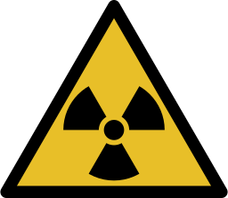
Introduction to Radon and Radioactivity
Maggie & Peter Williams

Slide 2
Basic Characteristics of Radioactivity and Radon
Radon spectrum; 400 nm - 700 nm
Creative Commons CC0 1.0

Slide 3
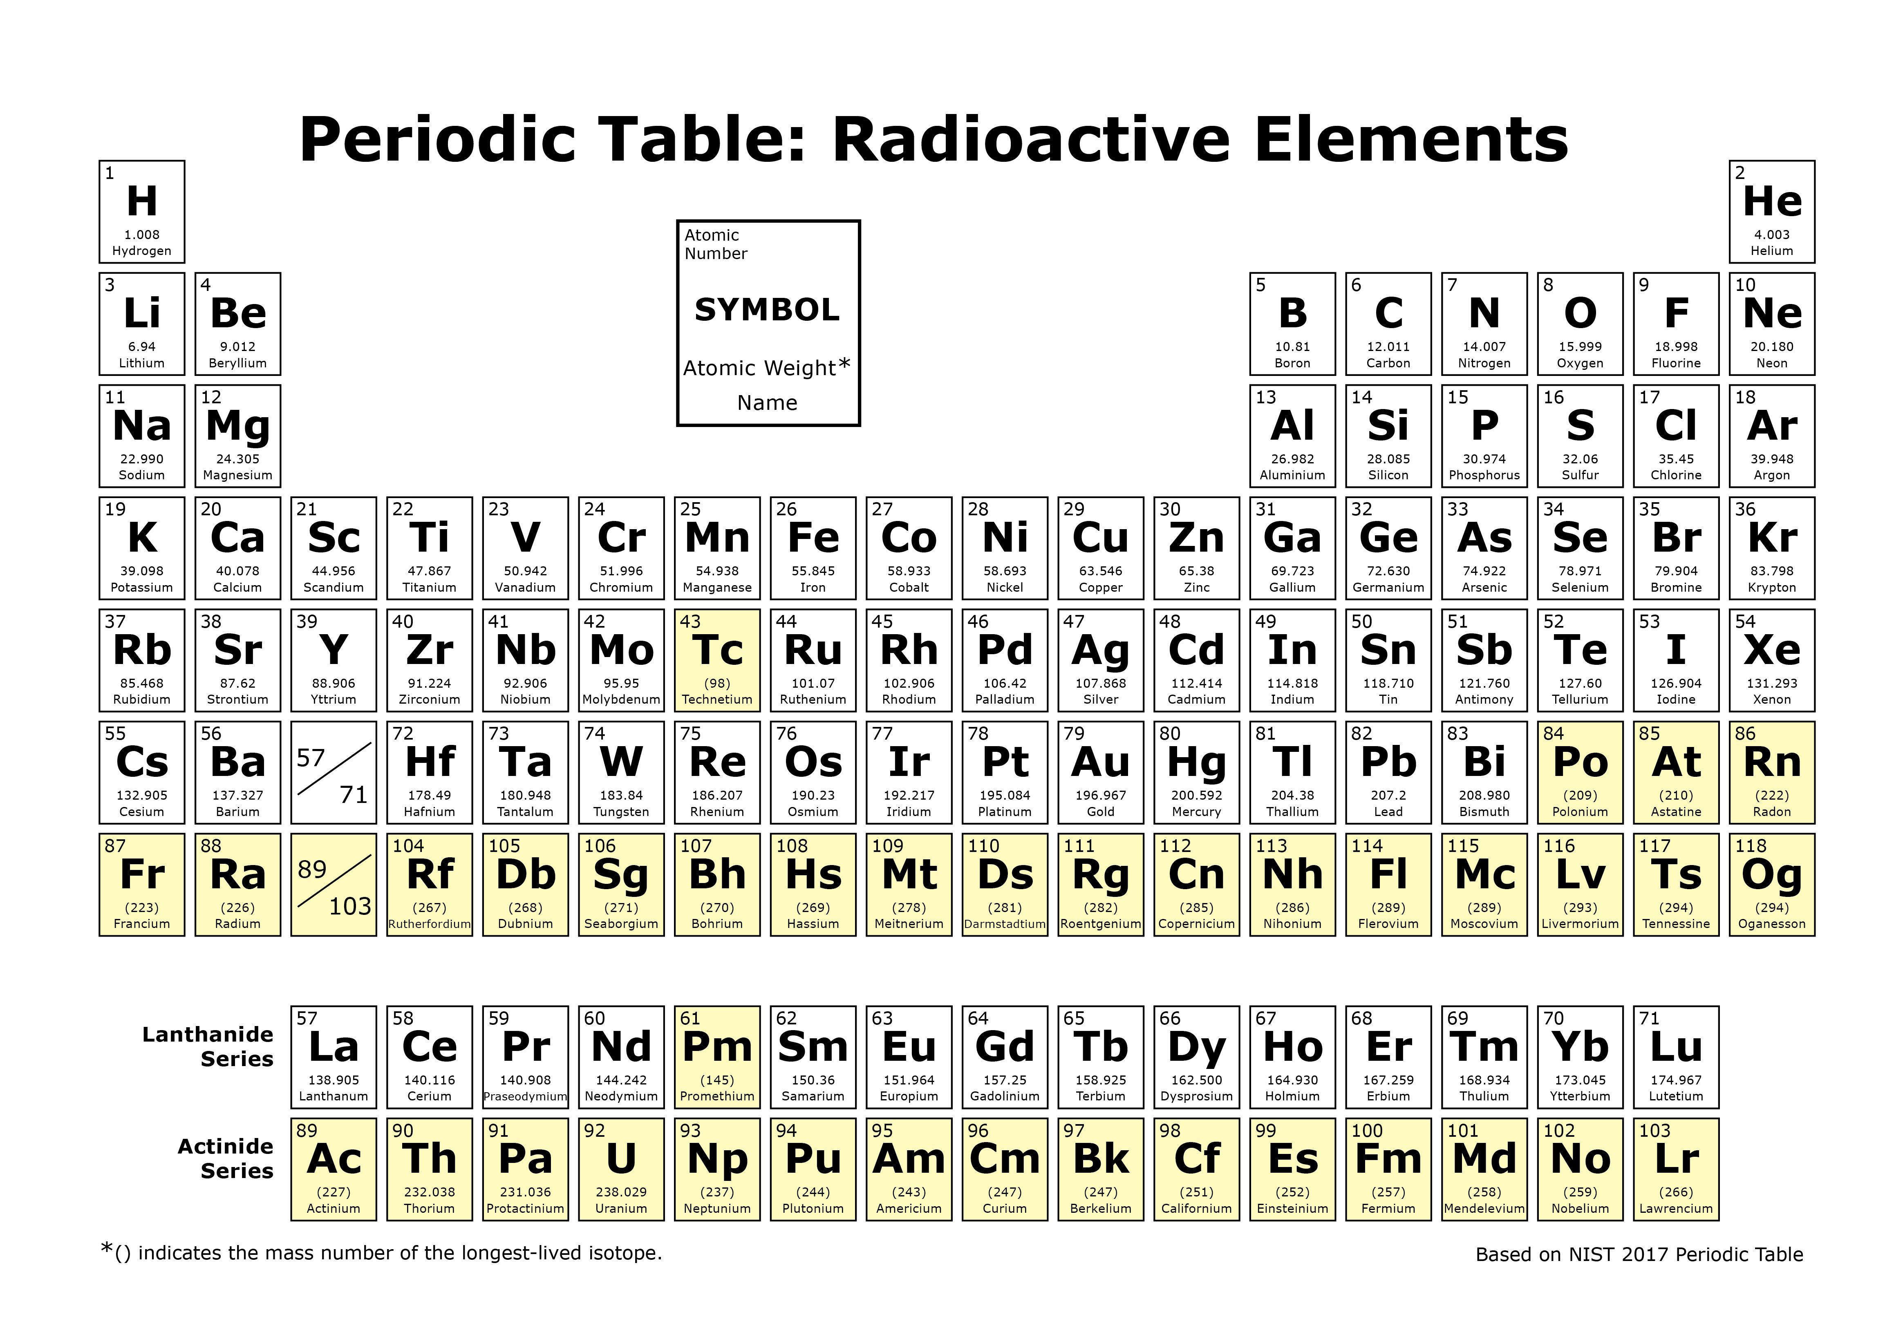
Radon (Rn) characteristics
Colourless gas
Odourless gas
Tasteless gas
Naturally occurring
Radioactive
Inert, does not chemically react (Noble gas)
20 radioactive isotopes known
Credit: https://www.epa.gov/radiation/radiation-sources-and-doses

Slide 4
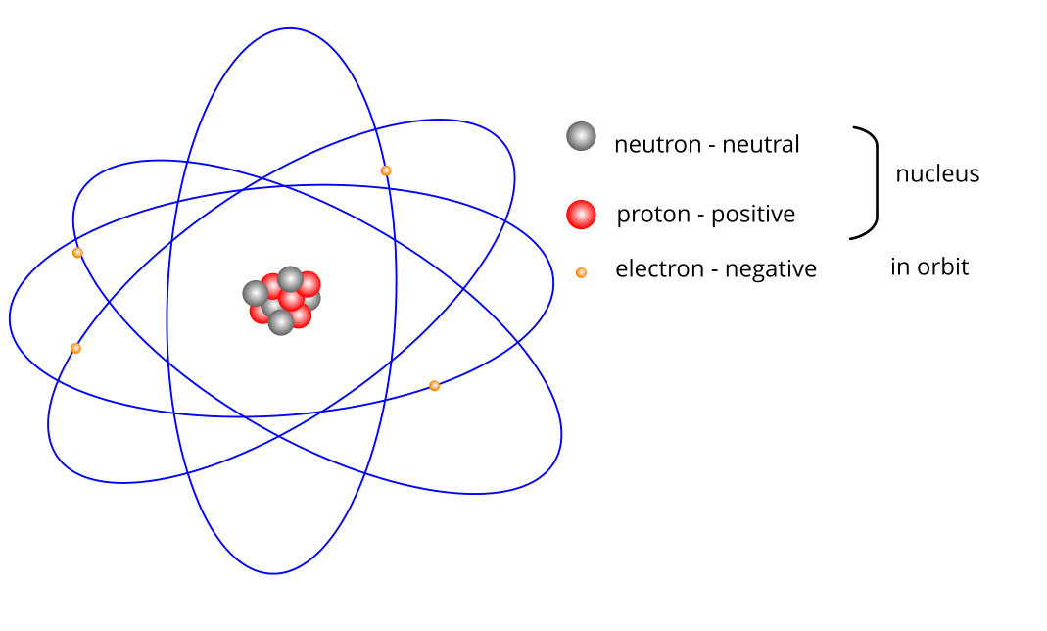
Simple model of an atom
Atom comprised of:
Nucleus
Protons (+)
Neutrons (neutral
Electrons (-)

Slide 5
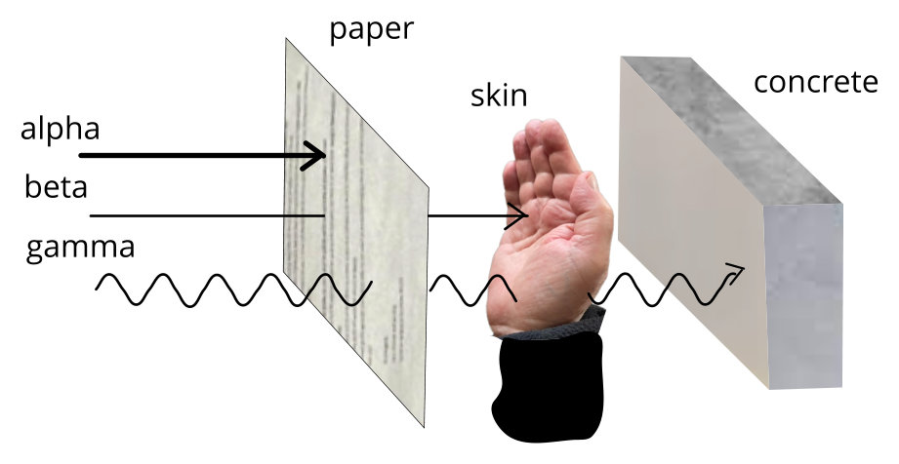
Relative penetrative power of radiation
Radioactive atoms can give off four types of ionizing radiation:
alpha particles,
beta particles,
gamma rays, and
neutrons.
Each type of radiation has different properties

Slide 6
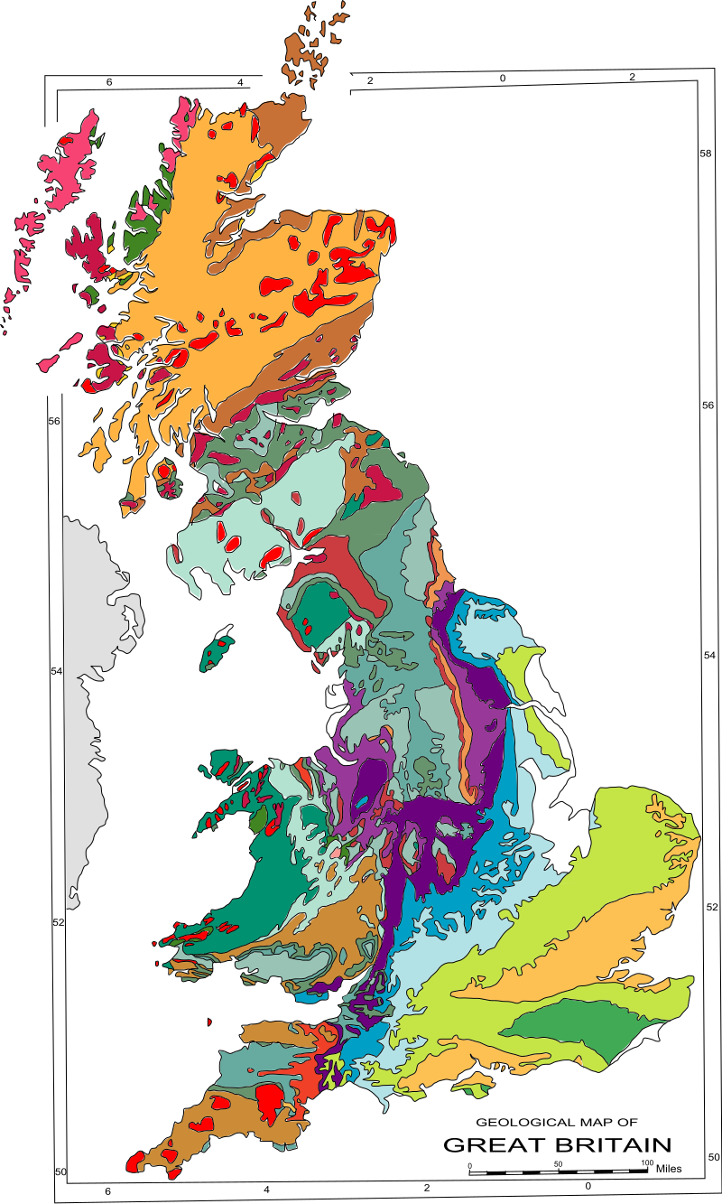
Where radon is found in the UK
Geology Map of Great Britain
Credit: AlexD CC BY-SA 3.0
Radon forms by radioactive decay of other elements
(uranium and thorium) and is mostly found in areas where
the rocks have a higher uranium content such as:
igneous rocks like granite (e.g. parts of Scotland & Cornwall)
rocks intruded by igneous rocks like granite (e.g. Cornwall)
dark, organic-rich shales (e.g. Wales)
limestones (e.g. Carboniferous Limestone in Derbyshire)
sedimentary rocks containing phosphate minerals (e.g. Northamptonshire Sand)
Radon occurs in rock, soil, water, air, the buildings we live in
and underground in caves, mines and tunnels.

Slide 7
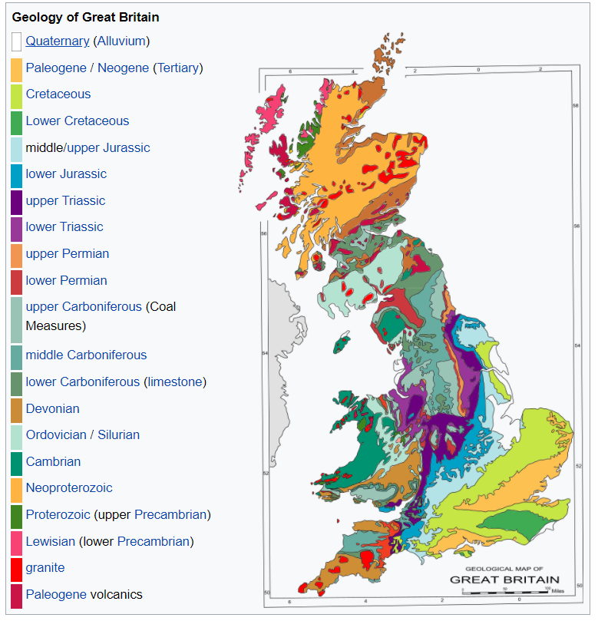
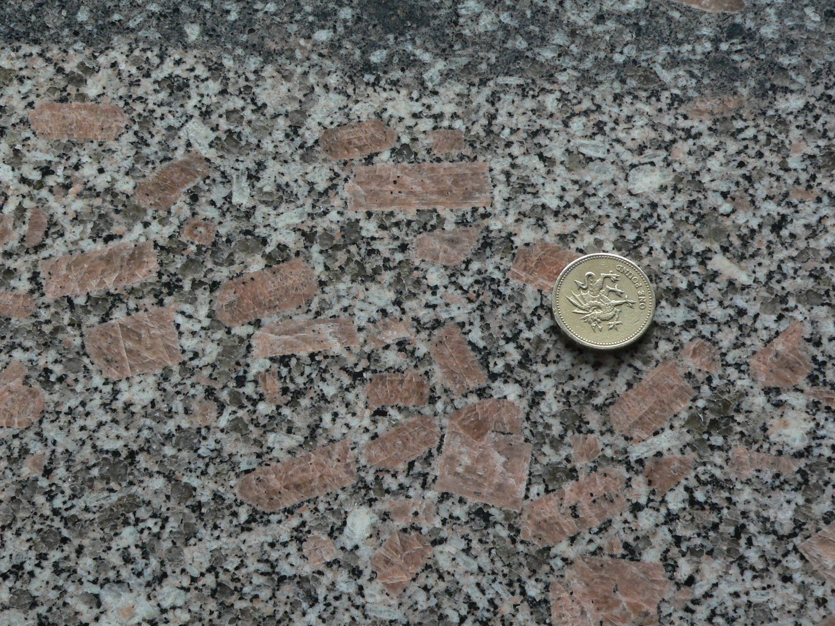
UK granite samples

Slide 8
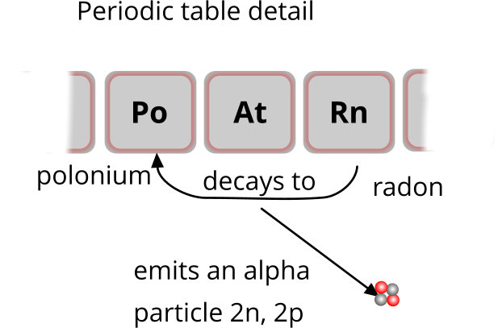
Radioactive decay of radon

Slide 9
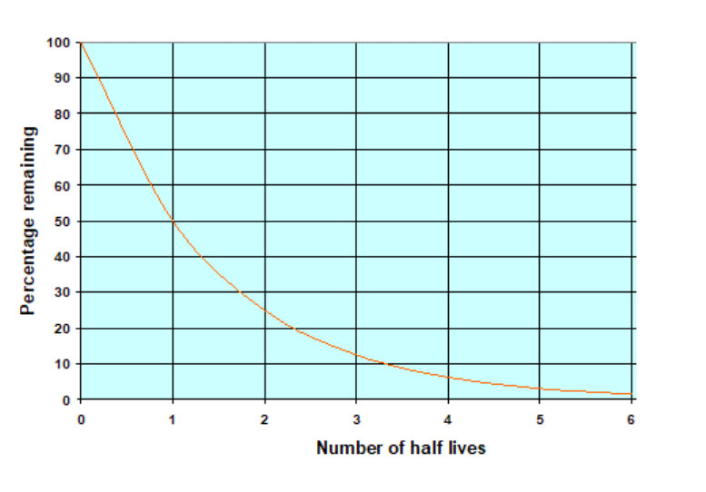
The meaning of half-life
Half life is the time required for half of the original number of atoms to decay
It is not the time for all the atoms to decay

Slide 10
Half lives of radon isotopes
Rn-219 4 secs
Rn-220 55 secs
Rn-222 3.8 days
All other isotopes have half lives less than 15 hours, and many are seconds or fractions of seconds.

Slide 11
Radon measurement units
The concentration of radon in the air is measured in units of becquerels per cubic metre (Bq m⁻³).
One Bq equals one disintegration per second.
n.b. The Action Level (AL), the level at which the UK Health Security Agency recommends that radon levels should be reduced in homes, is 200 Bq m⁻³.

Slide 12
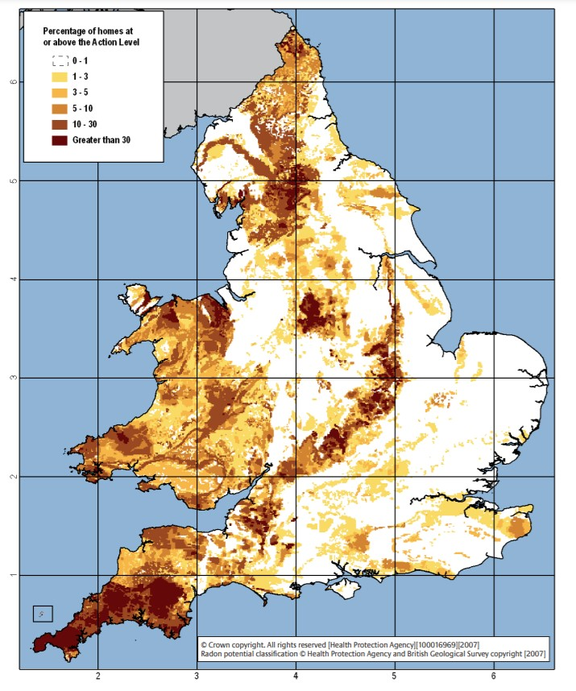
UK Survey results
– England & Wales
% of houses above UK Action Level of 200 Bq m⁻³
Highest numbers in granite-rich regions
Credit: https://www.ukradon.org/radonmaps/

Slide 13
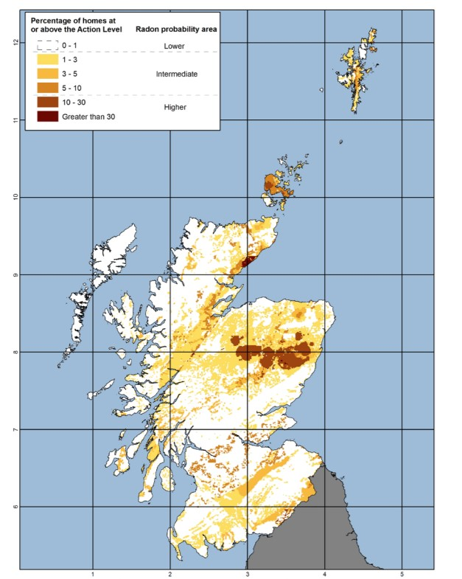
UK Survey results – Scotland
% of houses above UK Action Level of
200 Bq m⁻³
Highest numbers in granite-rich regions
Credit: https://www.ukradon.org/radonmaps/

Slide 14
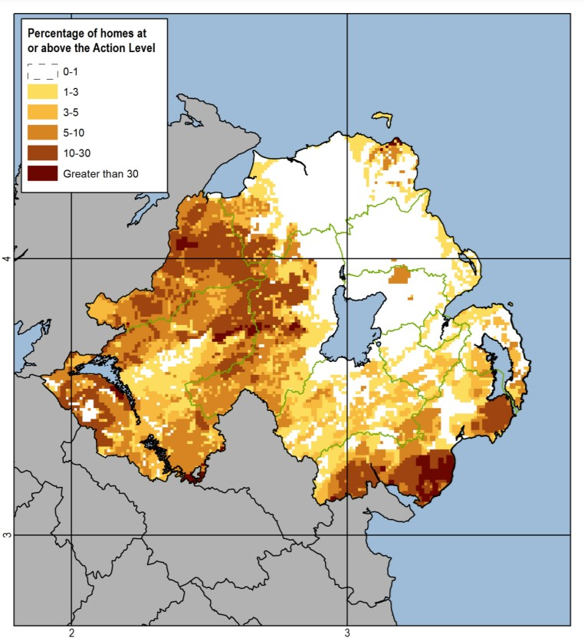
UK Survey results
– Northern Ireland
% of houses above UK Action Level of
200 Bq m⁻³
Highest numbers in granite-rich regions
Credit: https://www.ukradon.org/radonmaps/

Slide 15
2. Health Effects of Radon
and its Decay Products
Radon spectrum; 400 nm - 700 nm
Creative Commons CC0 1.0

Slide 16
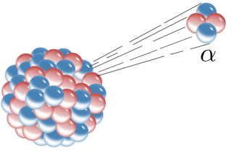
Radon decay products (RPDs): characteristics
Source of cell damage in lungs
Short-lived products most significant
Have static charges
Chemically reactive
Solid particles
Heavy metals
Alpha decay
Credit: Inductiveload CC BY-SA 3.0

Slide 17
Radon is a known human carcinogen
Alpha particles from the radon decay products can damage lung tissue
Lung cancer is the main health effect. Globally radon is the second commonest cause of lung cancer in smokers and the primary cause of lung cancer in non-smokers.
Historical background:
An “unknown” lung disease in the 1400s
Identified in 1879 in autopsies of European miners as lung cancer lymphosarcoma
Excess lung cancer deaths observed in uranium miners in US, Czechoslovakia,
France and Canada
Excess lung cancer deaths in other underground miners in Newfoundland, Sweden,
Britain, France, China and US

Slide 18
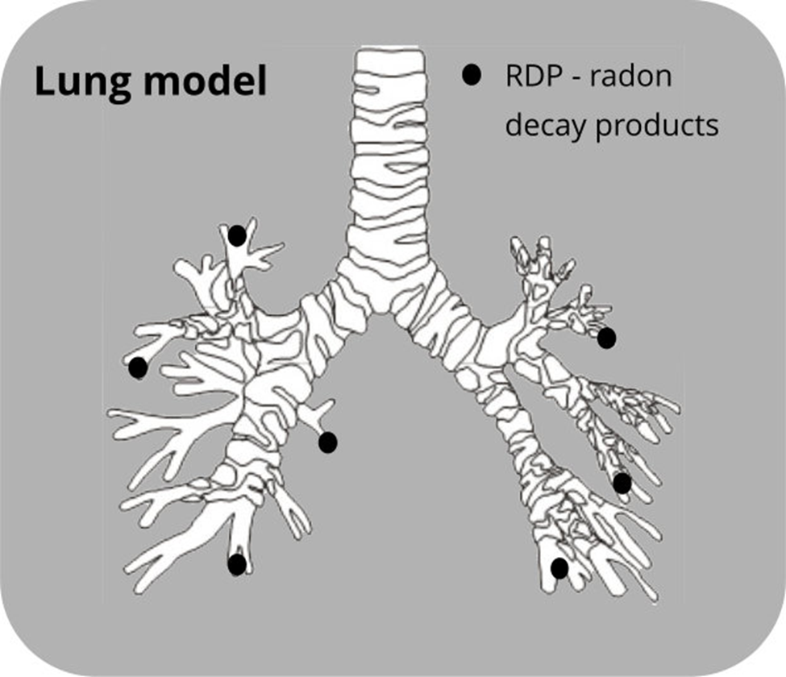
How lungs are affected by radon
Radon (RDPs) breathed in
Radon exhaled
RDPs remain stuck to lung tissue
Po-218 and Po-214 emit alpha particles
Alpha particles strike lung cells causing physical and/or chemical damage to DNA

Slide 19
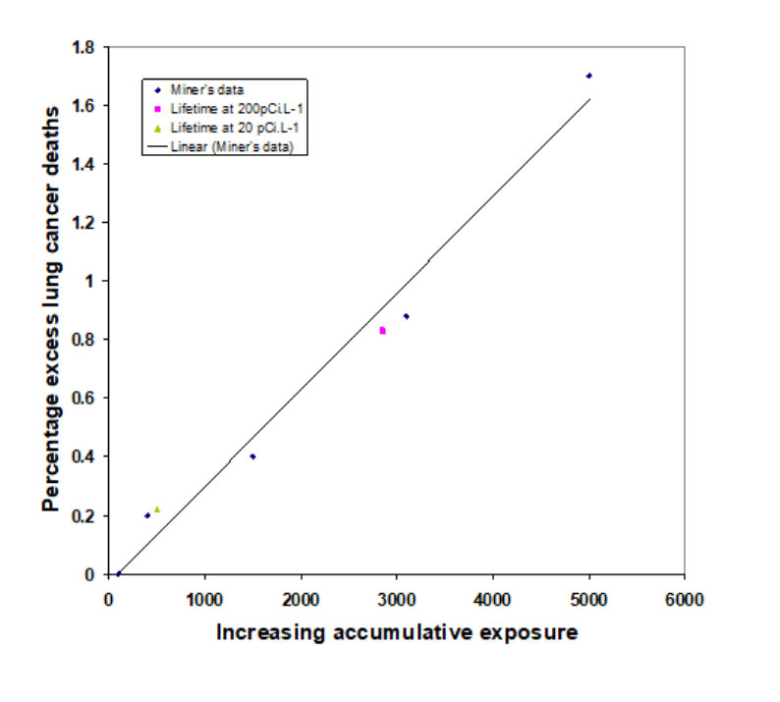
Excess lung cancer risk: studies on miners
Linear
No threshold
Indicates no safe level
Many homes can provide similar cumulative exposures

Slide 20
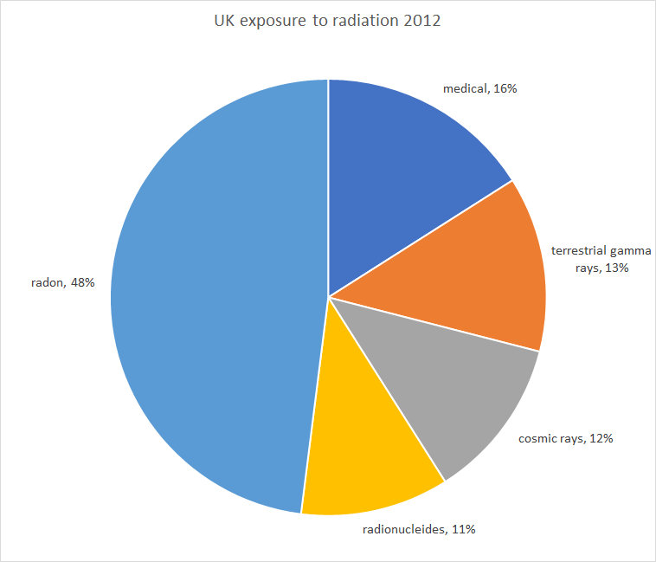
Sources of radiation to the UK population
Radon is by far the greatest single source.
The UK Action level (AL) is 200 Bq m^{-3.} A lifetime at this level would cause lung cancer in 1 in 30 people.

Slide 21
3. Radon Entry and Behaviour
Radon spectrum; 400 nm - 700 nm
Creative Commons CC0 1.0

Slide 22
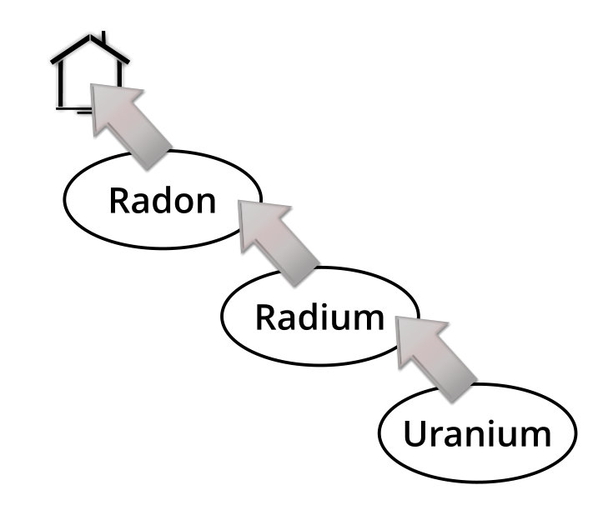
Radon entry
Pathways for radon to enter a building:
Pores, cracks and fissures in underlying soil and rock
Loose fill beneath foundations
Along utility/service trenches
Along water drainage systems
Level of radon in a building depends on:
Concentration of uranium in the soil or
underlying rocks
The ease of transport into the building
The ventilation rate of the building

Slide 23
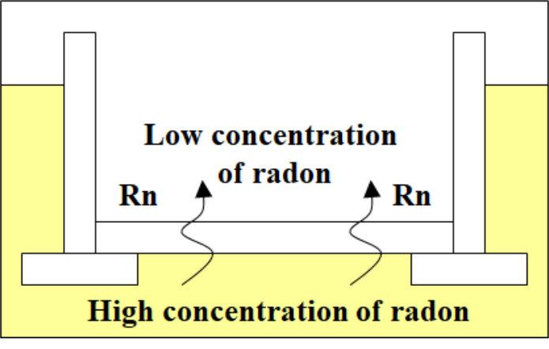
Entry route:
Diffusion-movement of radon through materials
Caused by concentration
gradients
Generally, a low entry rate

Slide 24
Entry route: Emanation-radon released from material surfaces
Rocks and other building materials can contain uranium and radium
Radon created on surface can be emitted into room
Rate depends on radium/uranium content and surface area

Slide 25
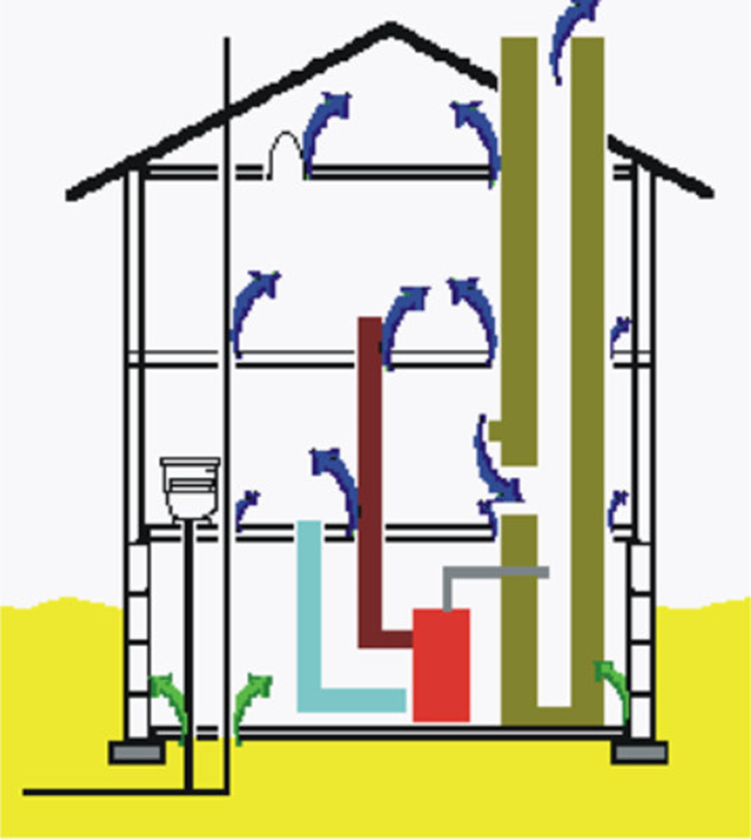
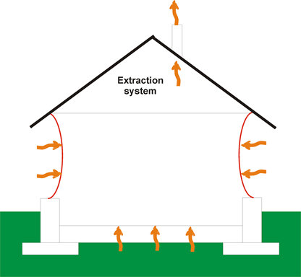
How entry is affected by building features
Exhaust systems such as extractor fans can increase the amount of outside air and soil gas entering the house and increase radon entry
Openings between floors in a building encourages upward movement of warm, light air - this enhances the stack effect

Slide 26
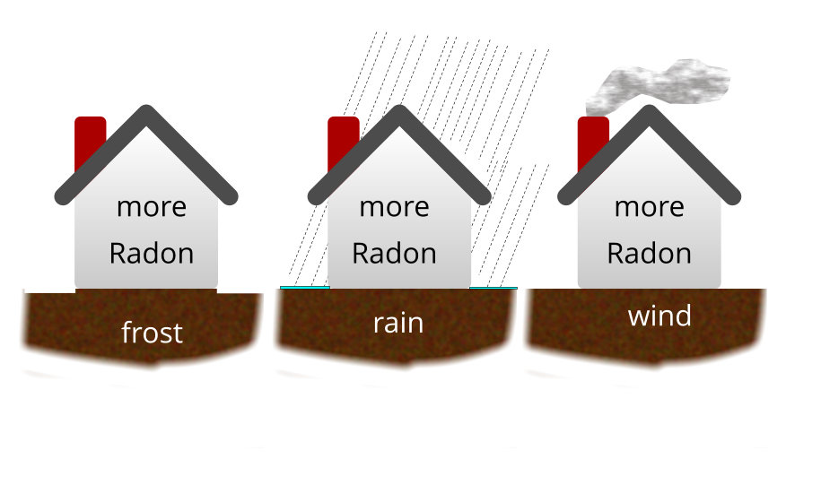
Factors affecting radon concentrations

Slide 27
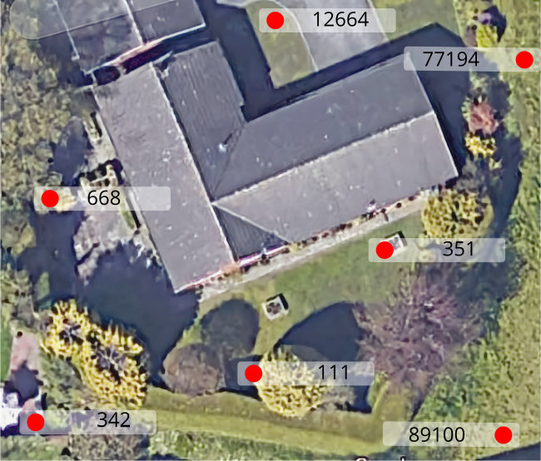
Radon concentrations from soil gas vary between locations

Slide 28
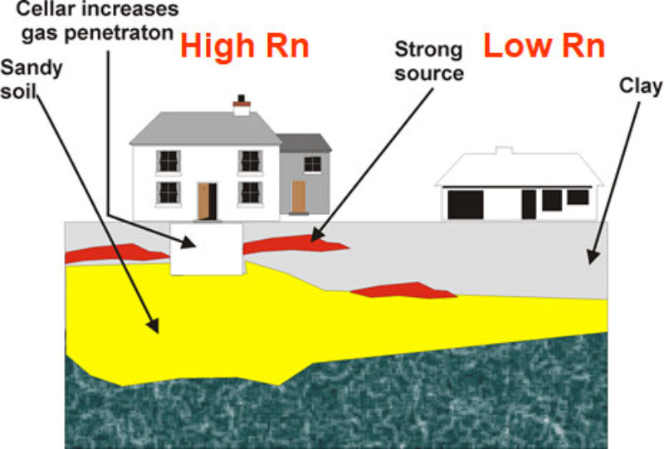
Why radon concentrations differ in nearby houses
Differences depend on:
How they are constructed
How close they are to the sources
The underlying soil composition
The different airflow patterns (through cracks and pores in the rocks, soil & buildings)

Slide 29
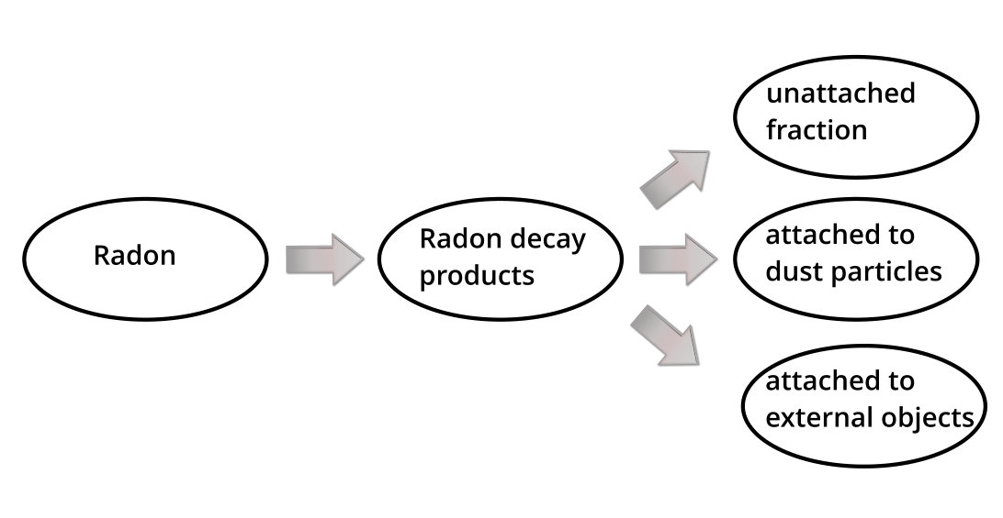
Fate of indoor radon

Slide 30
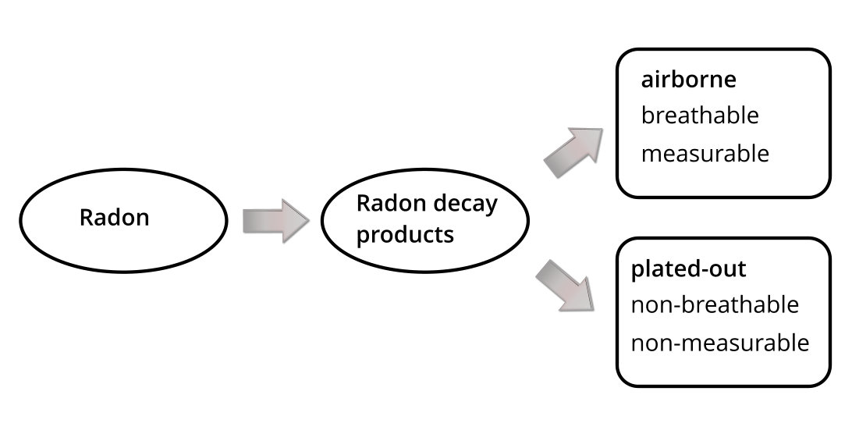
Fate of indoor radon (continued)
N.B. Plated-out: this refers to the percentage of RPDs that get attached to surfaces.

Slide 31
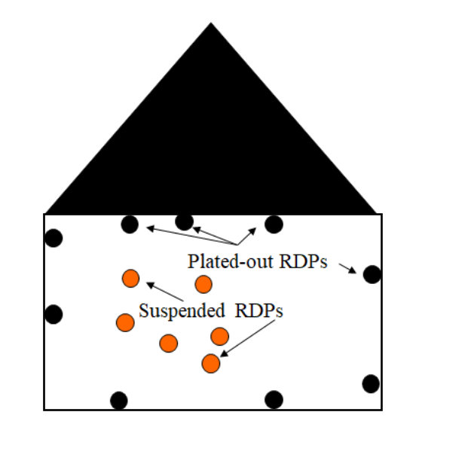
Equilibrium ratio (ER)
Factors affecting equilibrium ratio:
Air circulation – this increases plate-out thereby decreasing ER
Electronic air filters – decrease the RPDs attached to dust particles thereby decreasing ER
Suspended dust, smoke – increase sites for RPDs so fewer plate-out on walls
Recent ventilation – means inadequate time for RPDs to have been formed
ER varies from 0.3 to 0.7
This ratio describes the fraction of RDPs that are suspended in the air
and therefore measurable,
to the total RDPs created
ER = Measured RDPs
Total RDPs

Slide 32
Average contributions from radon sources in US homes

Slide 33
4. Radon Mitigation Strategies
Radon spectrum; 400 nm - 700 nm
Creative Commons CC0 1.0

Slide 34
Radon mitigation strategies
Reduce radon entry
By collecting radon prior to entry into the building and discharging it to a safe location
By modifying building and sealing entry points
Reduce radon concentrations after entry
By dilution with increased ventilation
By filtering radon and RDPs from the air
n.b. These methods work best when they are fan assisted
In July 2010 the Health Protection Agency (HPA) (now Public Health England, PHE) issued advice (HPA, 2010), recommending that radon exposure should be reduced where the annual average radon concentration exceeds the Action Level (AL) of 200 Bq m⁻³ and ideally to below the Target Level (TL) of 100 Bq m⁻³.

Slide 35
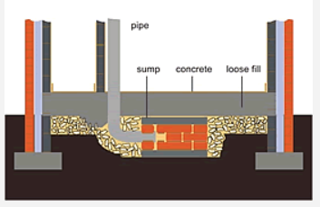
Examples of methods to reduce radon entry:
1. Radon sump
Protection added during new build.
Suitable for areas with a greater radon potential.
Radon sump is a small, bucket sized, cavity under the floor with an electric pump drawing air from it.
Vents the radon gas outside the building where it quickly dissipates.
Credit:
https://www.ukradon.org/information/reducelevels

Slide 36
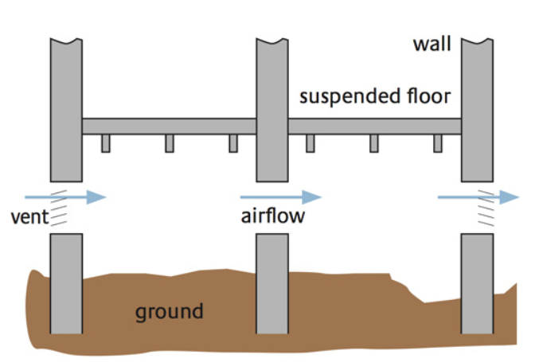
Examples of methods to reduce radon entry:
2. Natural under-floor ventilation
Suitable for homes with a suspended ground floor with a space underneath.
Good ventilation of this space can reduce indoor radon concentrations.
Works best if fan assisted.
Credit:
https://www.ukradon.org/information/reducelevels

Slide 37
Examples of passive remedial measures used to reduce radon levels
Passive sump:
Small space or void under a concrete capping or a membrane. The void is connected to an exit pipe, normally extending above the roofline, so the radon in air under the building is extracted.
Natural ventilation of living spaces:
Ventilation is improved using fresh air vents, such as trickle ventilators in windows or vents through walls. This dilutes the radon concentration in the building.
Sealing radon entry routes:
Sealing gaps in floors, joins between walls and floors and gaps where service pipes penetrate the floor could reduce radon gas in the building.
Advantages of passive measures:
Require little maintenance
Environmentally friendly
No running costs.
Disadvantages of passive measures:
Less effective than powered
systems, but reduction may be
sufficient to reduce radon levels.
Passive or natural under-floor ventilation:
Airflow to the under-floor space increased by clearing and/or adding more air bricks. This dilutes concentration of radon gas entering the building.

Slide 38
Did you know?
Earth scientists:
provide an understanding of geological structures, rock types &
their radon potential and the associated hazard.
evaluate the radon potential of an area and show this information on maps.
study combinations of data from:
- geological maps
- soil surveys
- stream surveys showing radon levels in surface waters that can be matched to
uranium distributions and fault & fracture patterns
- airborne geophysical surveys: gamma-ray spectrometry instruments mounted on
aircraft measure natural radiation of potassium, thorium and uranium emitted
from surface rocks & soil - and these data help them to map indoor radon
- radioactivity maps

Slide 39
Further information
Information about radon
https://www.ukradon.org/information/
Radon maps:
https://www.ukradon.org/radonmaps/
Technical solutions to radon protection in new build and existing dwellings in radon affected areas
https://www.bre.co.uk/page.jsp?id=1626
Information on radon and reports from the Centre for Radiation, Chemical and Environmental Hazards (CRCE)
https://www.gov.uk/government/collections/radon
Radon spectrum; 400 nm - 700 nm
Creative Commons CC0 1.0

