Slide 1
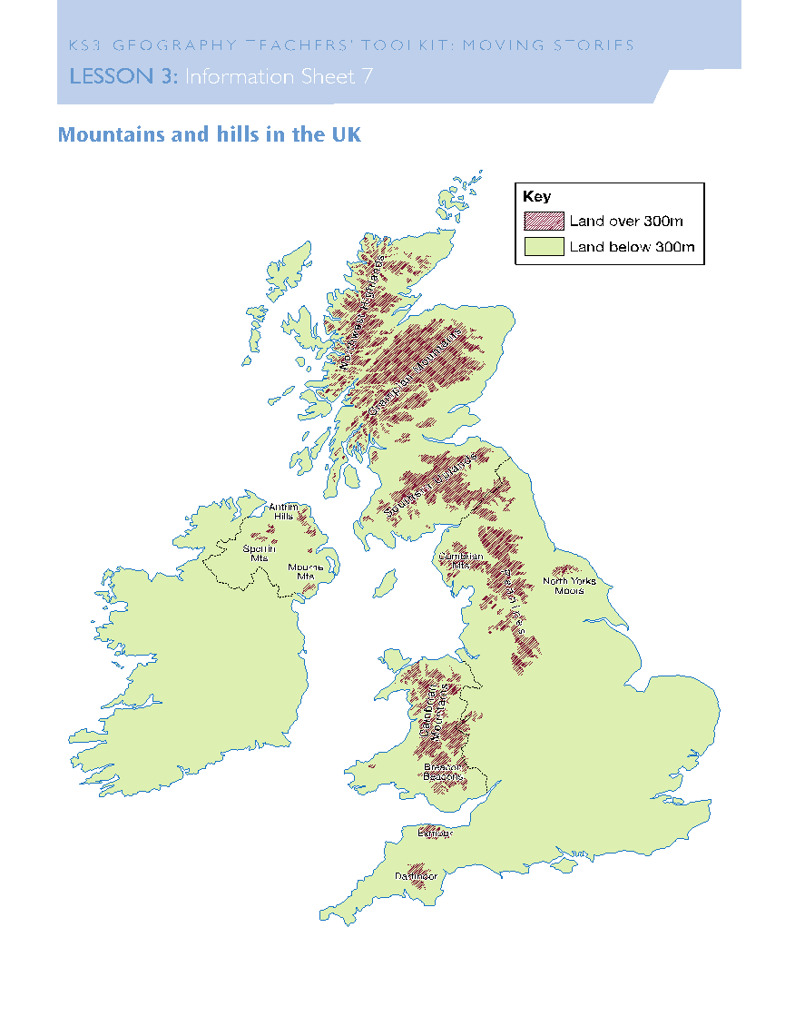
UK Mountains
Task: Use google maps or an atlas to find the name for the 4 mountain ranges labelled on the map.
Mark them on your map.
Geography genius: Can you add any more? Can you name any of the mountains?

Slide 2
Grampian
mountains
UK Mountains
Mark your work!
Mourne Mountains
The Pennines
Cambrian mountains

Slide 3
Why are there mountains?
Task: Where in the UK do you think these images might be from?
Geography genius: why have you said these locations?
1
2

Slide 4
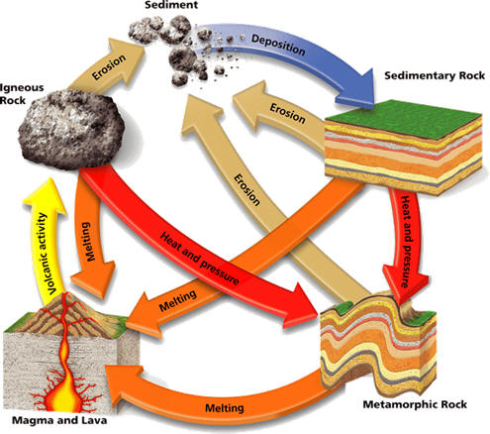
Why are there mountains?
The shape of the land is influenced by the type of rock which is underground. Some rocks are harder and so do not erode as easily (wear away) and so these make mountains and highland areas. Other rocks are softer and erode more easily and so make flatter and lowland areas.
Task: watch the video about the rock cycle and complete the diagram in your booklets labelling the 3 types of rock
Sedimentary rock
Igneous rock
Metamorphic rock

Slide 5
Task: Use the information sheets on the next few slides to fill in your table about the rocks in your booklet.
When we return your geography genius will be to identify the rocks I have in the classroom!

Slide 6
Rock type | How is it made? | Hard or soft? | Landscape it creates | Where in the UK?
Sedimentary
Igneous
Metamorphic

Slide 7
Sedimentary rock
These rocks are made up of sediment that has been deposited (dumped) by either a river, the sea or the wind. Over millions of years they get compacted and cemented into rocks.
They have layers in them as different layers of sediment were deposited on top of each other.
Sedimentary rocks are soft and so are easy to erode. This means they create landscapes that are flat or with only small hills.
Examples of these rocks in the UK are found in the South East and include limestone, sandstone and siltstone.

Slide 8
Igneous rock
These rocks are made by volcanoes erupting lava which then cools and forms igneous rocks.
They are full of crystals which form as the lava cools into rock form.
Igneous rocks are hard and so do not erode easily. This means they create landscapes that are full of mountains.
Examples of these rocks in the UK are found in the North West (i.e. Scotland) and include basalt and granite.

Slide 9
Metamorphic rock
These rocks are made from either sedimentary or igneous rocks that have been changed by being heated or put under pressure.
Metamorphosis: a change of the form or nature of a thing
They have fewer crystals than igneous rocks and may have some layers which have been folded and bent out of shape.
Metamorphic rocks are hard and so do not erode easily. This means they create landscapes that are full of mountains.
Examples of these rocks in the UK are found in the North and West and include marble and slate.

Slide 10
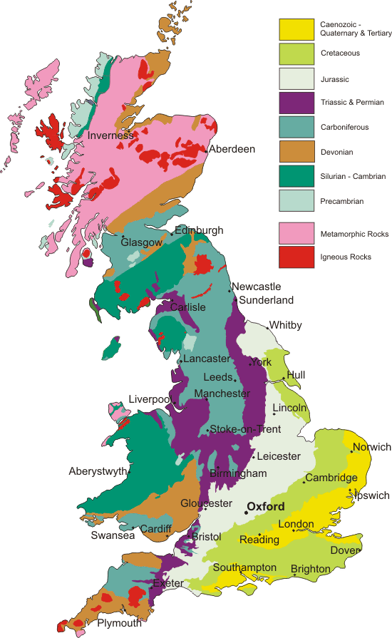
Key
Sedimentary rocks
Metamorphic rocks
Igneous rocks
Task: Describe the distribution of sedimentary, igneous and metamorphic rocks in the UK
Help: use compass directions to help complete:
Igneous rocks are mainly found in the ….
Metamorphic rocks are mainly found in the ….
Sedimentary rocks are mainly found in the ….
Geography genius: how does this link to link to the pattern of mountains across the UK?

Slide 12
Plenary – 3, 2, 1
Tell me …
3 things you have learned this lesson
2 things you found interesting
1 question you have

Slide 13
The Grampians
UK Mountains
Mark your work!
Mourne Mountains
The Pennienes
Snowdonia
Or
Cambrian

