Slide 1
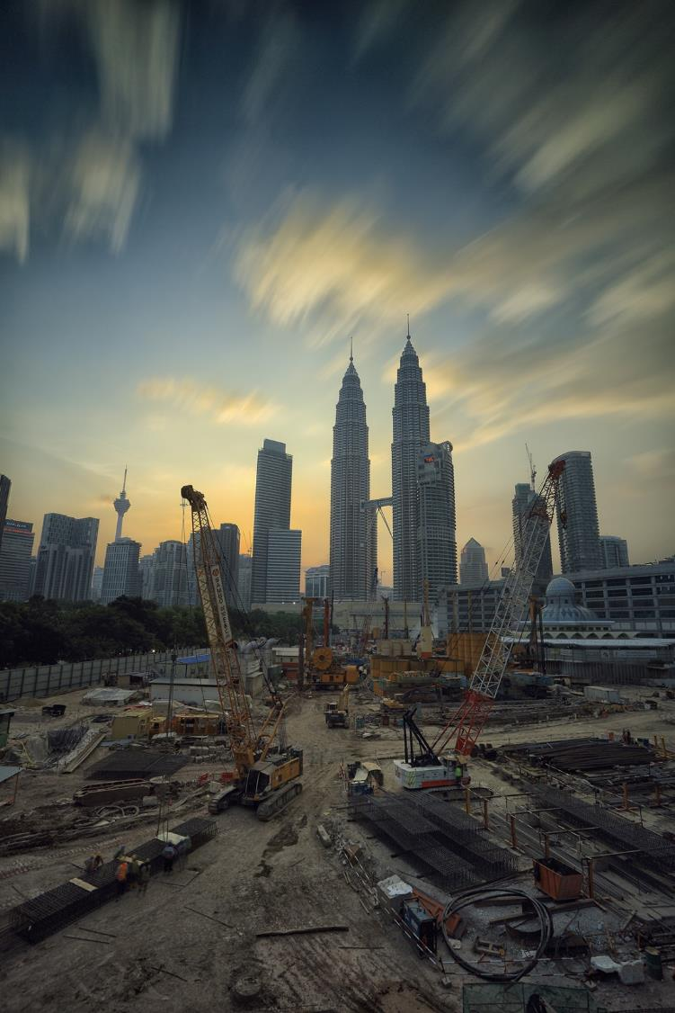
Remediation of industrial brownfield sites
Part 3: Groundwater technologies & physical barriers to development
Maggie Williams

Slide 2
Groundwater remediation technologies
Pump and treat
The most common method of treating groundwater.
Water is extracted, treated at the surface water and discharged.
Variety of methods used to return treated water to an aquifer.
One method is use of reinjection wells.
This method can be used to deal with leaks from petrol stations and storage tanks.

Slide 3
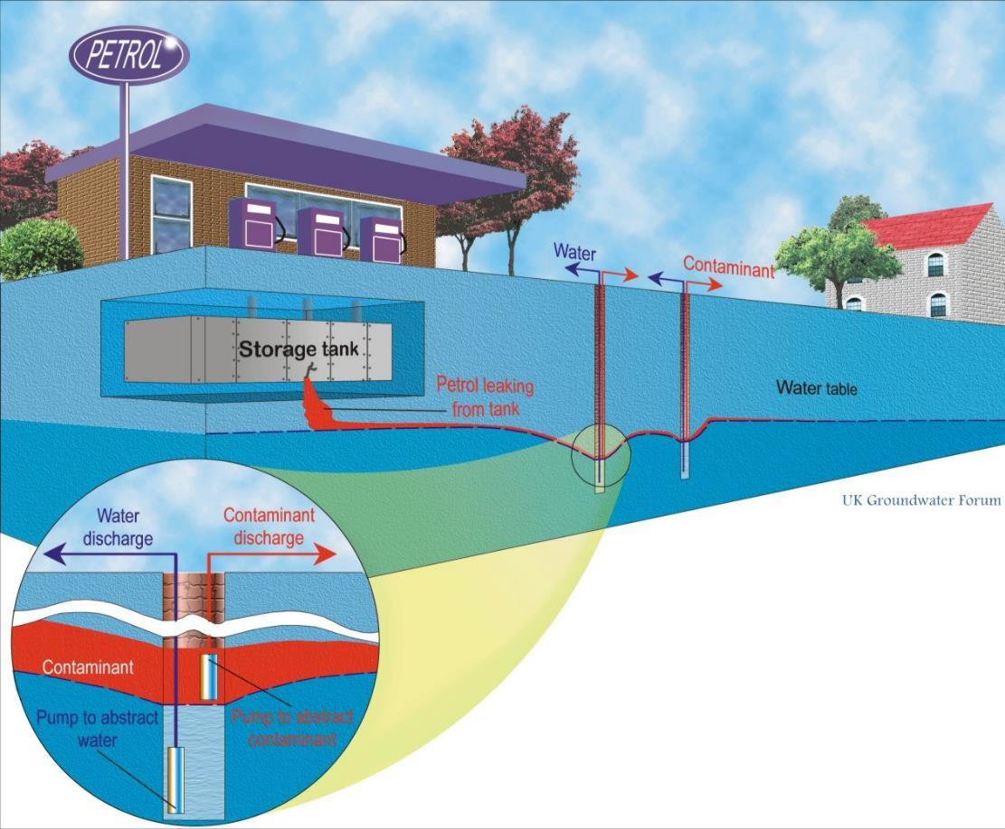
Pump and treat - leaks from petrol storage tanks
The boreholes contain 2 pumps, the lower pump abstracts water and creates a hydraulic gradient towards the borehole.
The upper pump abstracts the contaminant (petrol). Groundwater abstracted may have to be treated before being used or reinjected into the aquifer.

Slide 4
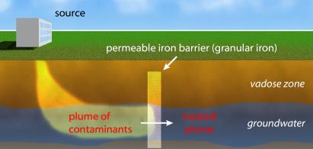
2. Permeable reactive barrier (PRB)
PRBs are barriers allowing some but not all materials to pass through. Often formed by:
excavating an area isolated by sheet piles
refilling the hole with a mixture of granular iron and sand
removing the sheet pile to leave an in-situ, permeable, iron-bearing treatment zone that removes contaminants (e.g. PCE and TCE) from groundwater.
Credit: This file is licensed by Tratnyek Research Group under the Creative Commons Attribution-Share Alike 3.0

Slide 5
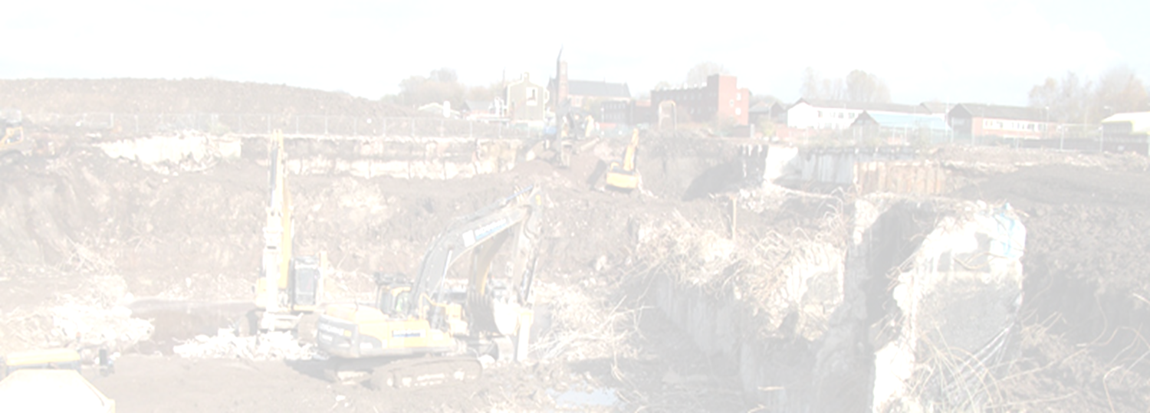
Physical barriers to development of brownfield sites
Constraints:
1. Ground instability e.g. subsidence, surface collapses or landslides (may be brought about through the legacy of historic activities or style of mining used).
2. Compressible strength
3. Slope stability
4. Dissolution
5. Major underground obstructions such as old foundations and machinery bases.

Slide 6
Dissolution & formation of sinkholes (or dolines)
By the surface dissolution of the soluble rock (solution sinkholes) e.g. limestone rocks dissolve when attacked by rainfall or groundwater that is acidic.
Where there is a thin covering of loose superficial material (e.g. sand, clay or soil) on the soluble rocks beneath
- soil can be washed into solutionally widened fissures
below, leading to the development of a cavity
- sand will tend to gradually slump into the fissures, slowly
creating a sinkhole over time (suffosion sinkhole)
- clay is more cohesive and the cavity can grow quite large
before suddenly collapsing and forming a 'drop out‘
sinkhole.

Slide 7
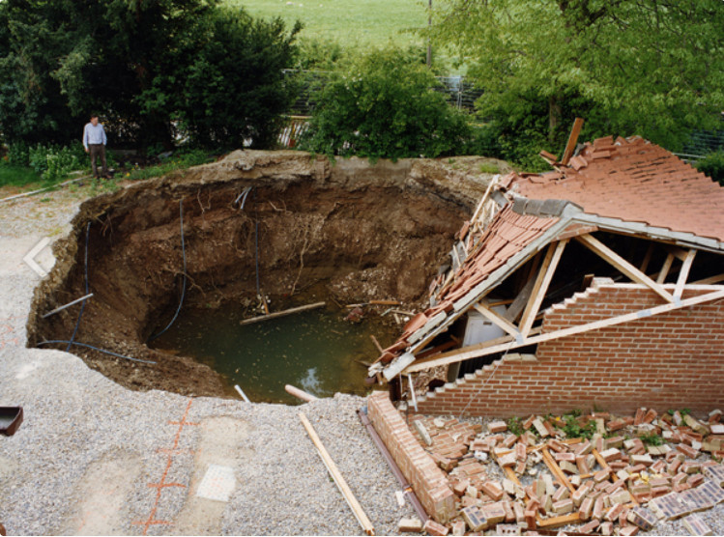
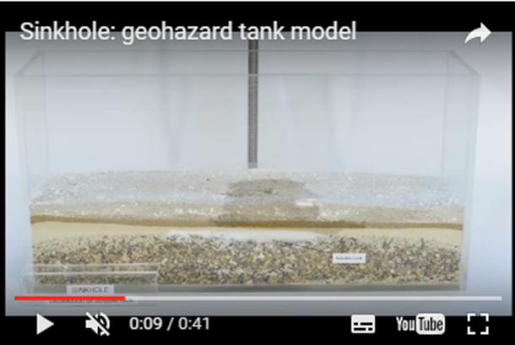
Sinkholes (or dolines)
Collapse of four garages into subsidence hollow caused by the dissolution of gypsum at Ripon, North Yorkshire, 1997.
https://youtu.be/6jWyHE3X9Uc
Credit: www.bgs.ac.uk/caves/sinkholes/home.html

Slide 8
Subsidence in brownfield sites
Possible causes:
Clay drying out (so subsoil shrinks) or becomes wet (so it expands).
Collapsing drains, culverts, hidden mine shafts.
Buried organic material which decomposes,
generates methane & carbon dioxide emissions and
destabilises all or part of building foundations.
Swallow holes or solution cavities.
Improperly compacted ground.
Sand or silt-based soils losing their water-soluble
plant nutrients, in a process known as leaching.

Slide 9
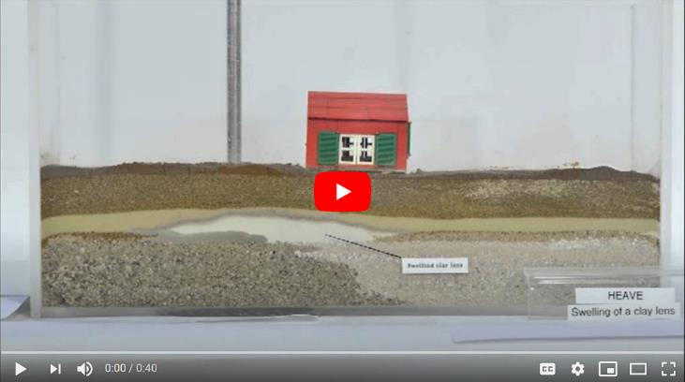
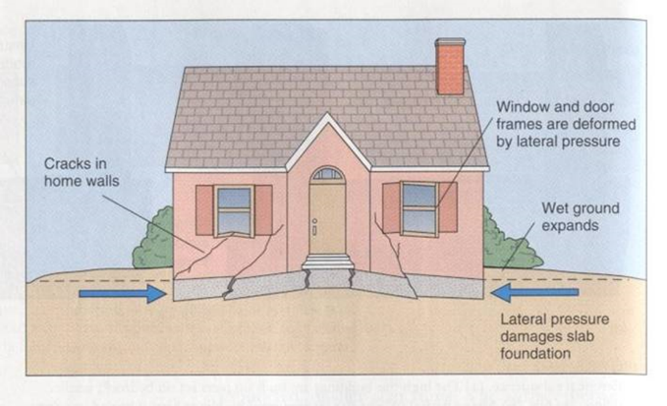
Problems caused by clay contracting & expanding
Ground moisture variations may be linked to man-made activity, weather variations & the growth or removal of trees. Variations can cause ground movement, particularly in upper 2m of the ground, which may affect building foundations, pipes or services.
https://youtu.be/WLuVLfg3G1Q
Effects of ground movement
Heave; during this video you can see the effect of a clay swelling due to water ingress and the subsequent damage to the house above.
Credit: www.bgs.ac.uk/caves/sinkholes/home.html

Slide 10
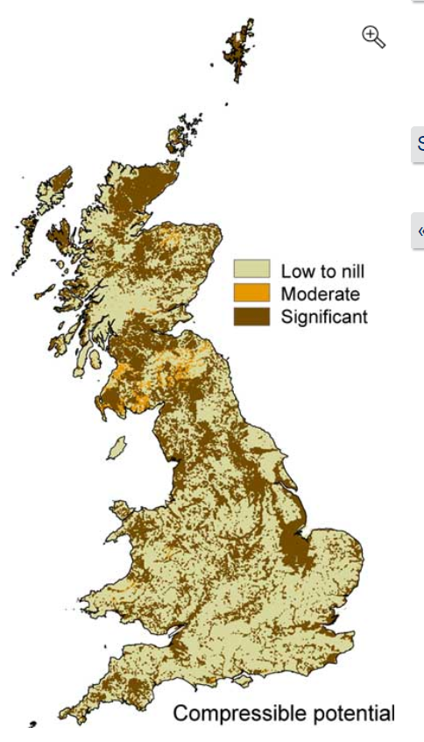
Compressible ground
Some types of ground may contain layers of very soft materials like clay, alluvium or peat. Layers may compress if loaded by overlying structures, or if the groundwater level changes. This may to depression of ground and disturbance of foundations.
Ground is compressible if an applied load causes the fluid in the pore spaces to be squeezed out causing it to decrease rapidly in thickness (compress).
If ground is very compressible, buildings may sink below the surface of surrounding ground or relative to adjacent structures.
If the compressible ground is not uniform different parts of the building sink at different rates or amounts (differential settlement).
Credit:
https://www.bgs.ac.uk/products/geosure/compressible.html

Slide 11
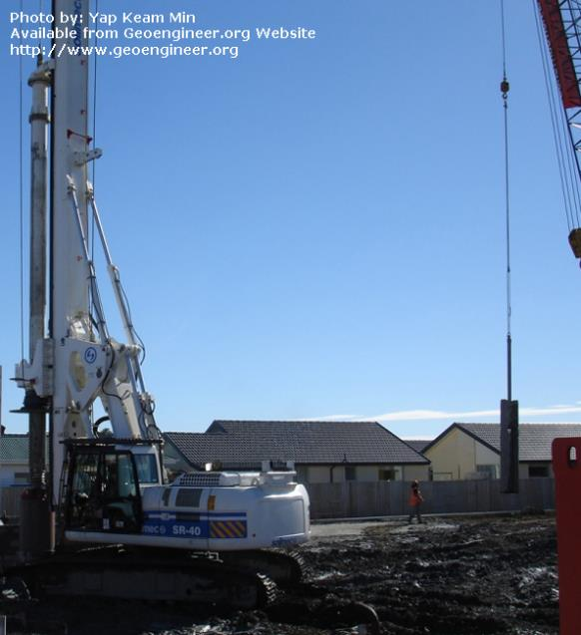
Subsidence & methods of remediation
If subsidence is serious - most common remedy is piling.
Soil is excavated from beneath existing foundations and replaced with material, usually concrete to form new foundations beneath the existing one.
Bored piling in New Zealand
N.B. Running sand hazards can occur where excavations in the sand go below the water table e.g. where springs occur at the base of sand outcrops.
See: https://www.bgs.ac.uk/products/geosure/running_sand.html

Slide 12
Pile foundations
Used if investigations show the ground is unsuitable and unworkable to a depth >2m and strip foundations are not appropriate.
A pile transmits the load deeper into the subsoil where denser material may occur, and the bearing capacity is greater.
Piles:
- can be driven into the ground or augured (bored)
prevent collapse and uplift
are thin columns of reinforced concrete, spaced out at regular intervals and at the intersections of walls, that go down deep into the ground.

Slide 13
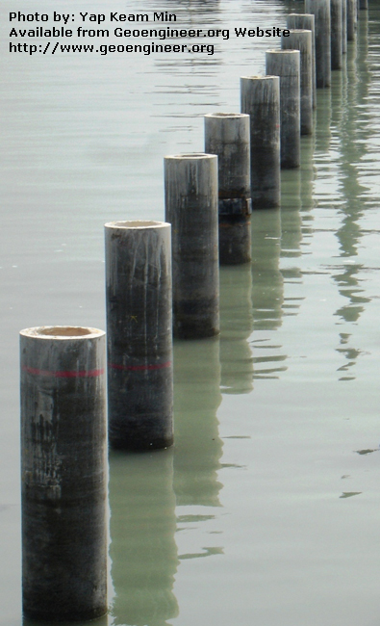
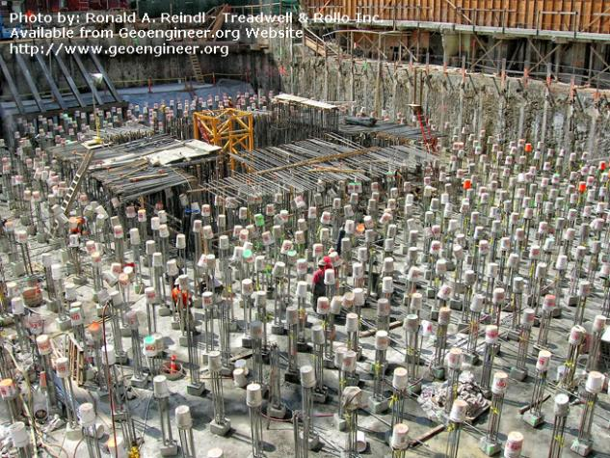
Piles
Constructed where:
the water table is high
clay soils are likely to swell or shrink excessively due to water content
removal costs for the excavated material are too expensive.
Precast spun prestressed concrete piles used in marine condition.
Mission Piles, San Francisco, CA. After the 900+ piles had been driven for the 60-story high-rise.

Slide 14
Other sources of information
USGS: Exploring contaminated land
https://www.usgs.gov/science-explorer-results?es=contaminated+land
US Environmental Protection Agency
https://www.epa.gov/environmental-topics
BGS: Engineering geology
https://www.bgs.ac.uk/research/engineeringGeology/home.html
International Information Centre for Geotechnical Engineers
https://www.geoengineer.org/education
Wikipedia: Brownfield land
https://en.wikipedia.org/wiki/Brownfield_land

