Slide 1
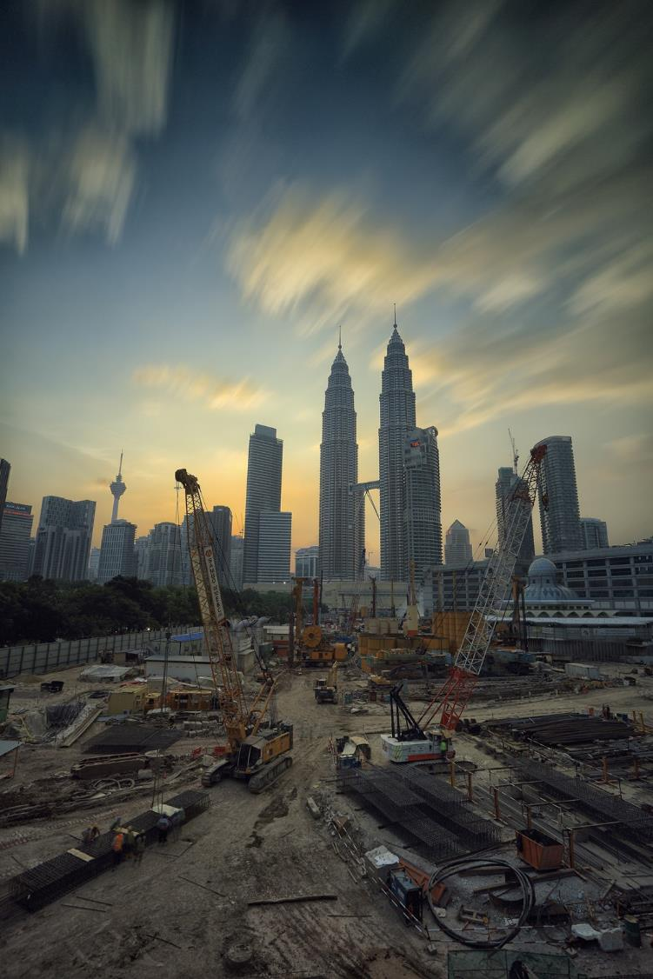
Remediation of industrial brownfield sites
Part 2: Physical & biological technologies
Maggie Williams

Slide 2
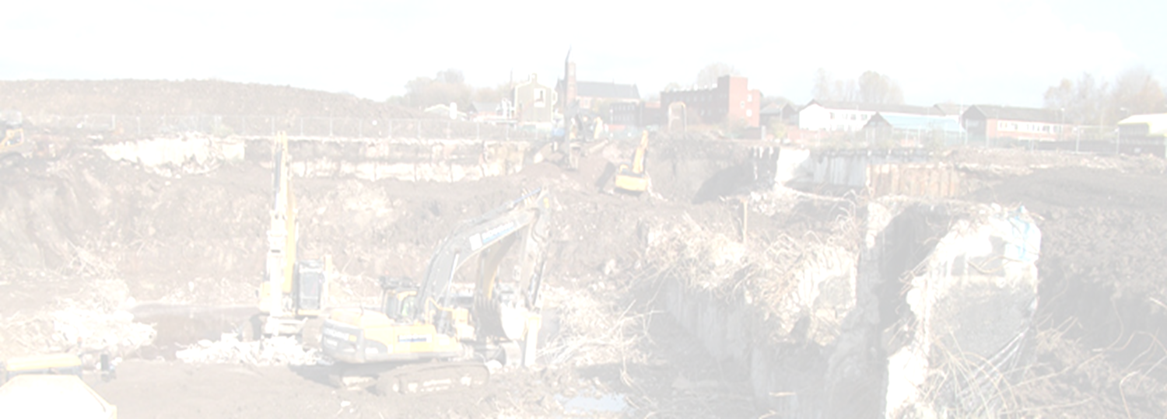
Development of brownfield sites
Special licences are required to reclaim/ develop brownfield sites.
Strict environmental regulations are in place.
All brownfield sites need to be assessed before they can be reclaimed and developed.

Slide 3
Stages in development of brownfield sites
Stage 1 - desktop study
review of historical records and old maps
check against the contaminated land register held by the Local Authority
check other information resources such as:
- Local Authority survey information
- River Basin Management Plans
- National Land Use Database
- Local Authority planning department records
appraise the site’s environmental setting including:
geology, hydrology and hydrogeology

Slide 4
Development of brownfield sites
Stage 2 - Risk assessment for contaminated sites
This involves an analysis of the soil, groundwater and surface water and testing for hazardous compounds.
A risk assessment for contaminated sites will:
identify what contaminants, if any, are present;
determine individual concentration levels for contaminants;
work out whether contaminants are inert or mobile;
describe migration pathways;
ensure that appropriate measures can be taken to reduce identified risks and liabilities.

Slide 5
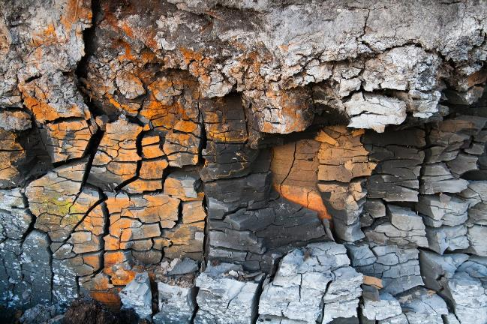
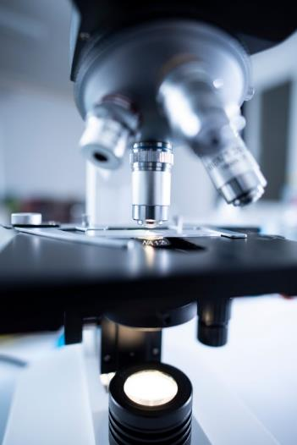
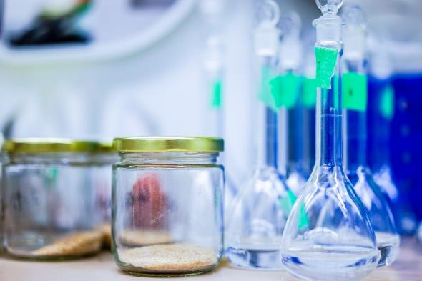
Measuring soil and groundwater contamination
Use portable drilling rig
Install a well
Collect soil samples during drilling
Collect & analyse
water samples for
possible pollutants
Install wells downstream from
the source of
pollution

Slide 6
Development of brownfield sites
Stage 3 – Remediation
This is the removal of all known contaminants to levels considered safe for human health.
Remediation can be expensive and complex.
Not all sites are considered suitable for remediation, particularly if the remediation costs exceed the value of the land after development.

Slide 7
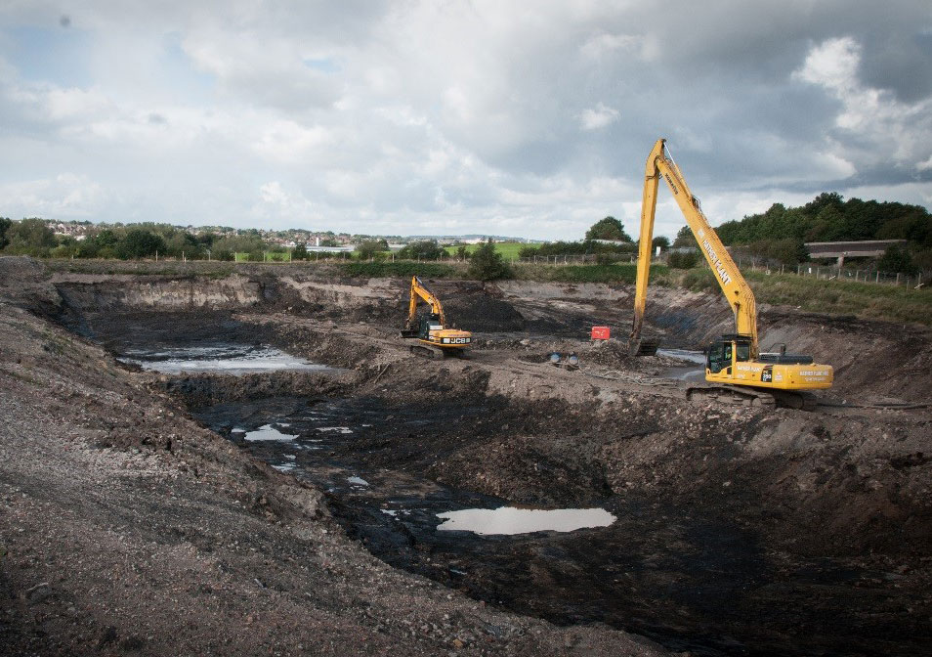
Physical remediation technologies
Credit: BGS

Slide 8
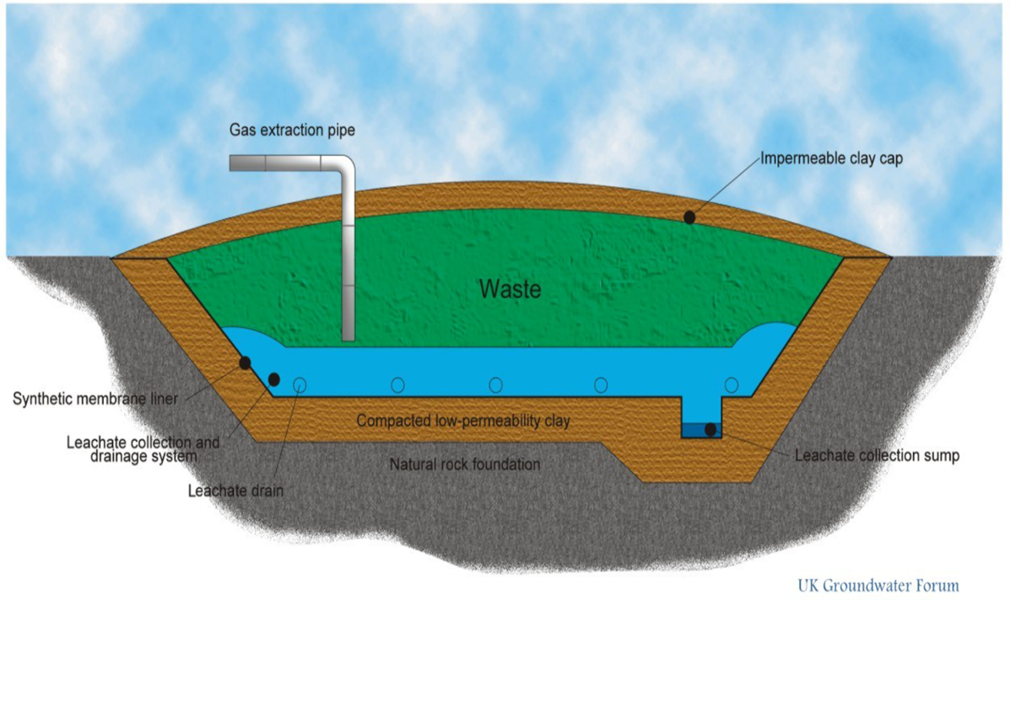
1. Excavation – removal of contaminated soil. Material is either treated on site and re-used for backfill or transported to a safe disposal site and material replaced by new soil
Pipe extracts methane gas generated
Reduces water flow into site & slows rate of decomposition
Leachate drains into a sump
Design of a modern landfill site

Slide 9
Landfill liners
Landfill Liners are constructed on the base and sides of a landfill site to prevent leachate from leaking into the surrounding soils.
Landfill Liners may be constructed from:
Compacted Clay
Bentonite Enhanced Sand
Geomembrane
Geotextile Protector
Dense Asphaltic Concrete (DAC)
Combination of the above

Slide 10
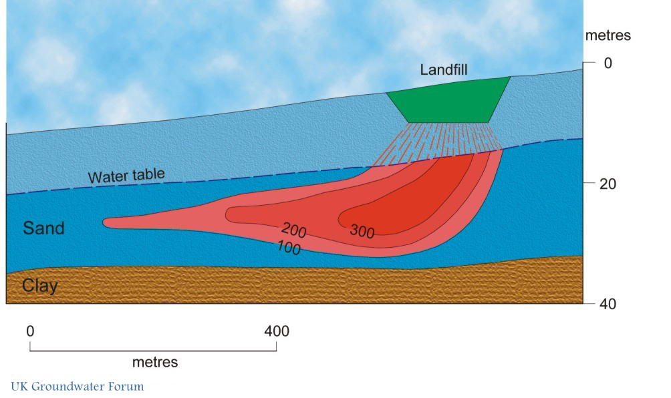
What happens without adequate containment?
UK Groundwater Forum
High chloride concentrations in the groundwater (units in mg/l) show the extent of the plume. The leachate plume migrates in the direction of groundwater flow.
n.b. This situation does not occur in modern landfill sites, but many in the UK are old, disused sites and classified as contaminated land.

Slide 11
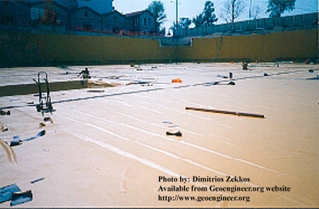
Physical remediation technologies
2. Cover system – use of geotextiles (synthetic materials) after excavation to provide a protective cover or barrier.
Often used to remediate sites after excavation
Cover is impermeable to contaminants & stops migration into the new soil
If geotextile fabric tears contaminants may pass through
Application of geomembranes as a hydraulic barrier in the basement of entertainment centre, Patras, Greece.

Slide 12
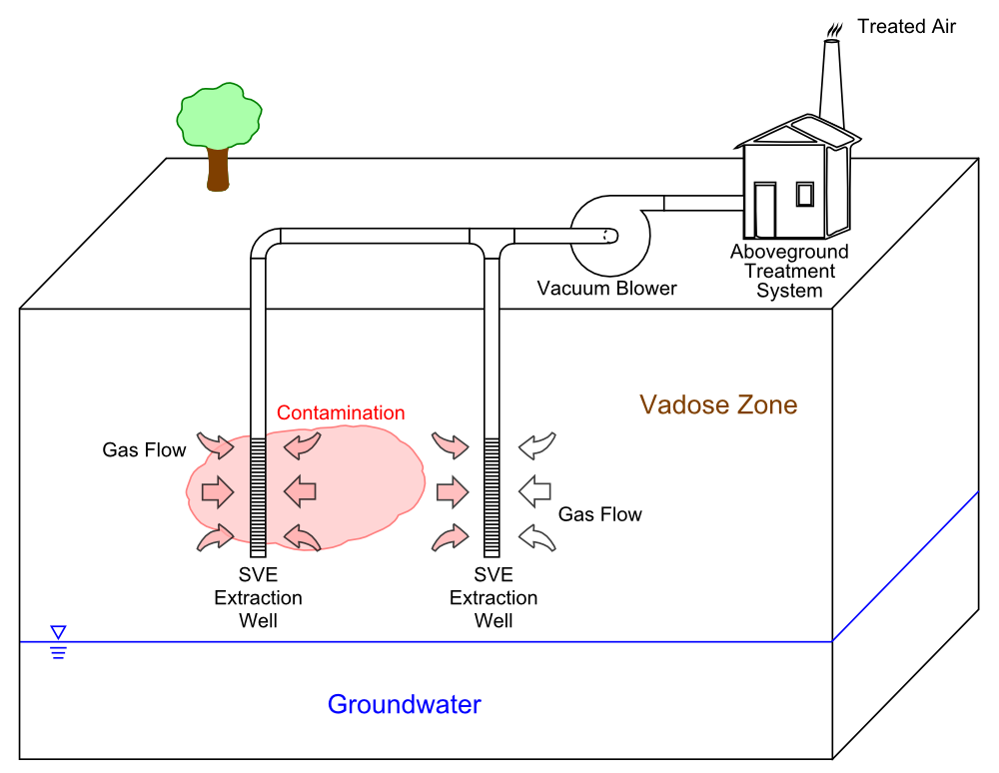
Physical remediation technologies
3. Soil vapour extraction (SVE) - a treatment process for in situ remediation of volatile contaminants in vadose zone (unsaturated) soils.
Credit: This file is licensed by Gwremed under the Creative Commons Attribution-Share Alike 3.0

Slide 13
Physical remediation technologies
The most important factor affecting the soil washing process is the percentage of fines (particles with a diameter less than 0.063mm) in the soil, if the percentage of fines is high then there will only be a small volume reduction in the amount of contaminated material and the efficiency of the soil washing process will be low.
Generally it is considered that if the fine content of the soil is above 25% then soil washing will not be effective. More granular soils are better suited to soil washing than cohesive or semi cohesive soils.
Soil washing – physical removal of the soil, followed by water-based treatment of excavated soil in a plant on or off-site.
The process removes contaminants by dissolving or
separating contaminants on soil particles in the wash
solution. After treatment, the washed/cleaned soil is
placed back on the ground.
Limitations:
Most contaminants bind physically or chemically to clay & silt particles which are themselves attached to sand & gravel grains in the soil. This means that if the soil has a fines content above 25% soil washing is not the most efficient remediation method to use.

Slide 14
Physical remediation technologies
I
Chemical oxidation can be conducted in-situ or ex-situ; chemical oxidants can be injected into the contamination ple beneath the capillary fringe or mixed into excavated soils and pumped groundwater.
5. In-situ chemical oxidation (ISCO) – injection of oxygen
or chemical oxidants into the soil or water to
chemically oxidise contaminants into less hazardous
compounds, which are more stable and less mobile.
Common oxidising agents used in this process are
hydrogen peroxide, potassium permanganate, ozone,
and sodium persulfate.
Limitations:
Costs may be high because the site may need more than one application &/or large volumes of chemical oxidants need to be used.
Process works best in soils with a low clay content.
Potentially hazardous chemicals may be used and could affect aquifer properties

Slide 15
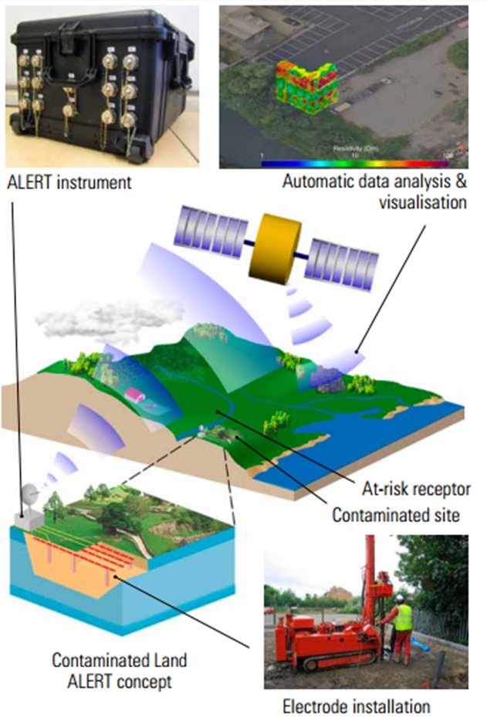
ALERT (Automated time-Lapse Electrical Resistivity Tomography)
Developed by BGS
Provides a method of monitoring contaminated land
Shows changes in the distribution and concentration of subsurface contaminants (particularly dissolved phase contaminants)
Uses the electrical properties of the ground to produce 3D images of contamination in near-real time.
Credit: BGS
Notes:
• provides 3D subsurface information throughout the whole monitoring volume (traditional sampling is limited to a number of specific locations)
• allows real-time measurement of geoelectric, hydrological and hydrochemical properties
• gives unprecedented sampling rates
• is non-invasive or minimally invasive
• uses permanent in situ-electrode arrays and ‘smart’ instrumentation
• can be interrogated remotely
• captures data with little or no intervention
• provides results via a BGS secure web portal

Slide 16
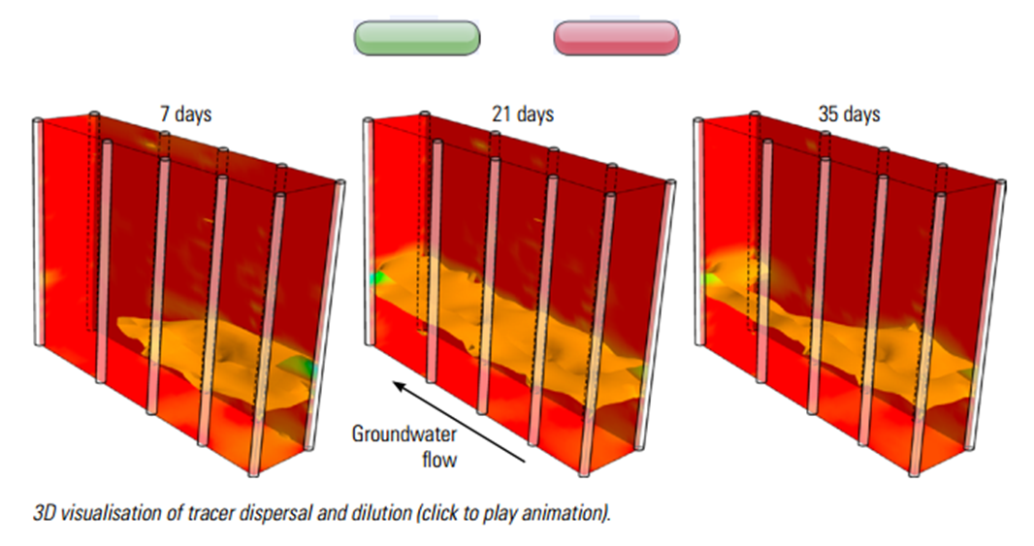
ALERT
http://www.bgs.ac.uk/research/tomography/video1.html

Slide 17
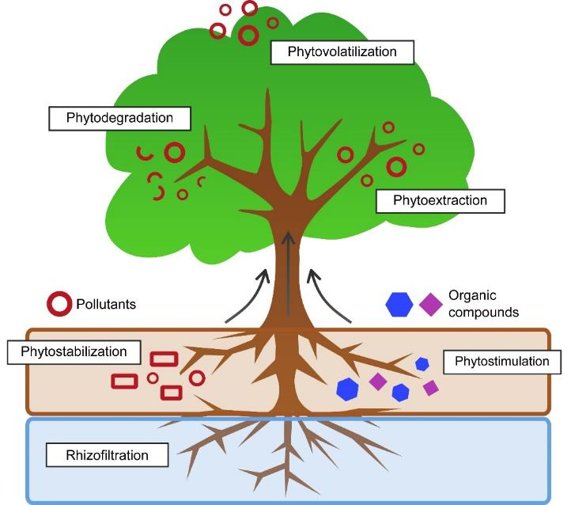
Biological remediation technologies
1. Phytoremediation
Using plants to degrade organic contaminants or extract toxic metals from the soil and transport them to the shoots above ground.
A hyperaccumulator - a plant that can store metal contaminants in its leaves & stems (bioaccumulation).
Credit: This file is licensed by Townie under the Creative Commons Attribution-Share Alike 3.0
Some contaminants e.g. heavy metals can be
harvested and ‘mined’ for reuse (phytomining).

Slide 18
Biological remediation technologies
1. Phytoremediation - and phytostabilisation
Phytoremediation is a comparatively inexpensive remediation method. It is also environmentally ‘friendly’.
Establishing vegetation also has the potential to:
- restrict or prevent wind erosion, leaching, surface
water runoff & erosion (phytostabilisation).

Slide 19
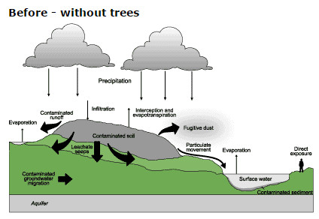
1. Phytoremediation and phytostabilisation)
Credit: https://www.forestry.gov.uk/fr/infd-62ac4t
Notes:
The thickness of the arrows indicates magnitude of movement.

Slide 20
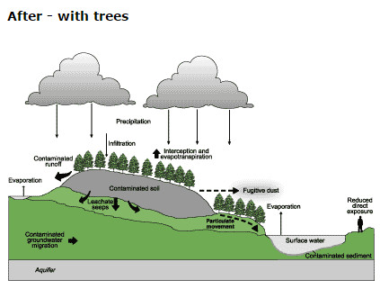
1. Phytoremediation and phytostabilisation (continued)
Credit: https://www.forestry.gov.uk/fr/infd-62ac4t
Notes:
The thickness of the arrows indicates magnitude of movement.

Slide 21
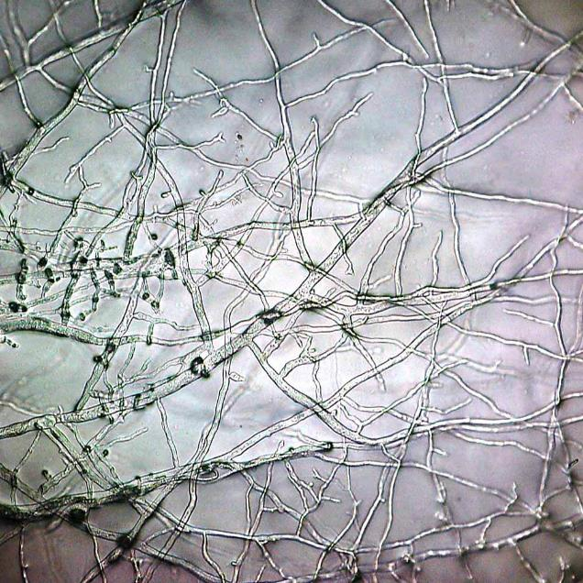
Biological remediation technologies
3. Fungal remediation (mycoremediation)
Use of certain species of fungus to degrade contaminants that are decomposed by fungal mycelium.
Microscopic view of a mycelium (part of a fungus, consisting of a mass of branching, thread-like hyphae.
This image covers a one-millimetre square.
Credit: This file is licensed by Bob Blaylock under the Creative Commons Attribution-Share Alike 3.0
Notes:
Particularly useful to deal with hydrocarbons.

Slide 22
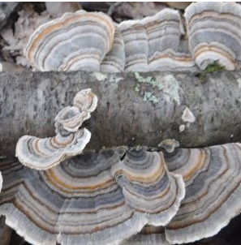
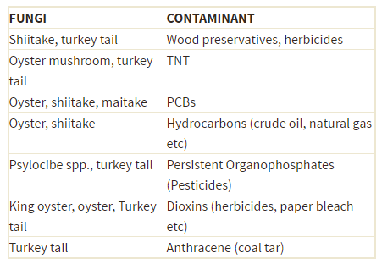
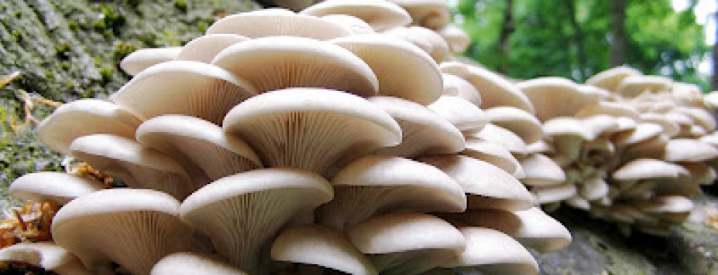
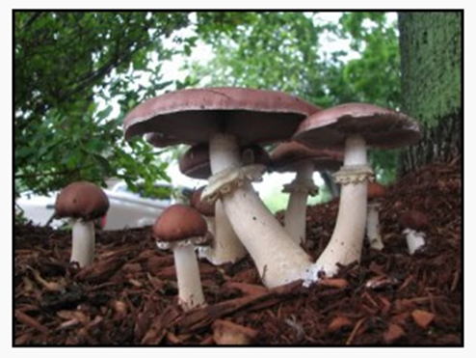
Credit: http://mushroommountain.com/p/visit-us
Credit: http://earthrepair.ca/resources/bioremediation-types/mycoremediation/
Notes:
Particularly useful to deal with hydrocarbons.
Top = Turkey tail

Slide 23
Biological remediation technologies
4. Microbial remediation
Use of microorganisms to degrade contaminants into less toxic form.
Microorganisms include:
- bacteria (aerobic and anaerobic)
- fungi
- actinomycetes (filamentous bacteria).
Effective in the treatment of hydrocarbons and polychlorinated biphenyl compounds (PCBs).
Can be carried out in-situ or off-site.
Notes:
Bioaugmentation particularly useful in situations such as oil spills where the naturally occurring microbes may die out because of the intensity of the contamination.

Slide 24
Relative biodegradability
Simple hydrocarbons and petroleum fuels
degradability decreases as molecular weight and degree of
branching increase
Aromatic hydrocarbons
one or two ring compounds degrade readily, higher molecular
weight compounds less readily degrade
Alcohols, esters
Nitrobenzenes and ethers
Chlorinates hydrocarbons
decreasing degradability with increasing chlorine substitution,
highly chlorinated PCBs less readily degrade
Pesticides
are not readily degraded
Increasing biodegradability

Slide 25
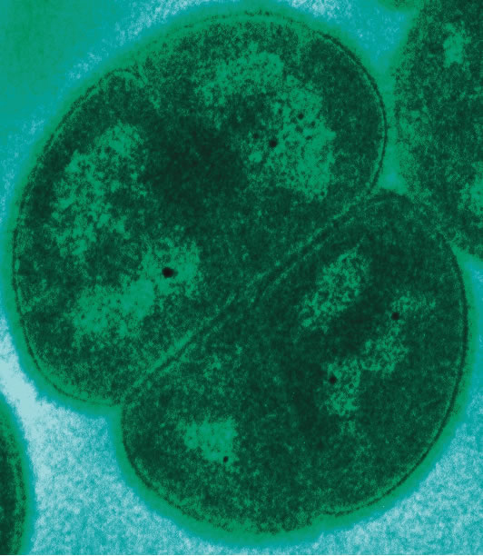
Grades of microbial remediation
1. Natural attenuation: process takes place naturally with indigenous soil microorganisms.
2. Biostimulation: natural processes receives external help in the form of nutrients, moisture and an ideal pH for the microorganisms.
3. Bioaugmentation: involves using externally introduced microorganisms.
Credit: TEM of Deinococcus radiodurans acquired in the laboratory of Michael Daly, Uniformed Services University, Bethesda, MD, USA.
Notes:
Deinococcus radiodurans - a soil bacterium capable of surviving radiation levels several times higher than what would kill humans.
The bacterium has demonstrated capabilities to break down radioactive mercury and toluene.

Slide 26
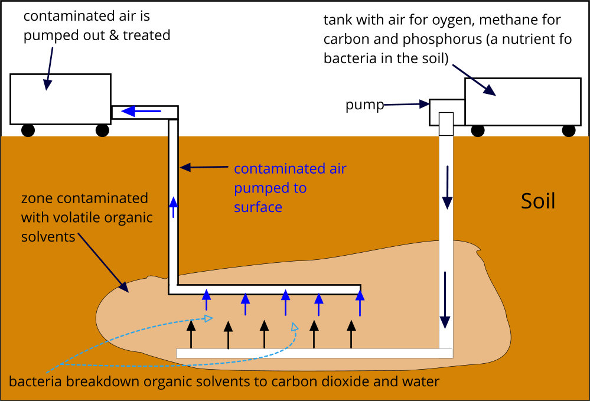
Biostimulation
Nutrients pumped into contaminated zone encourage bacterial growth

Slide 27
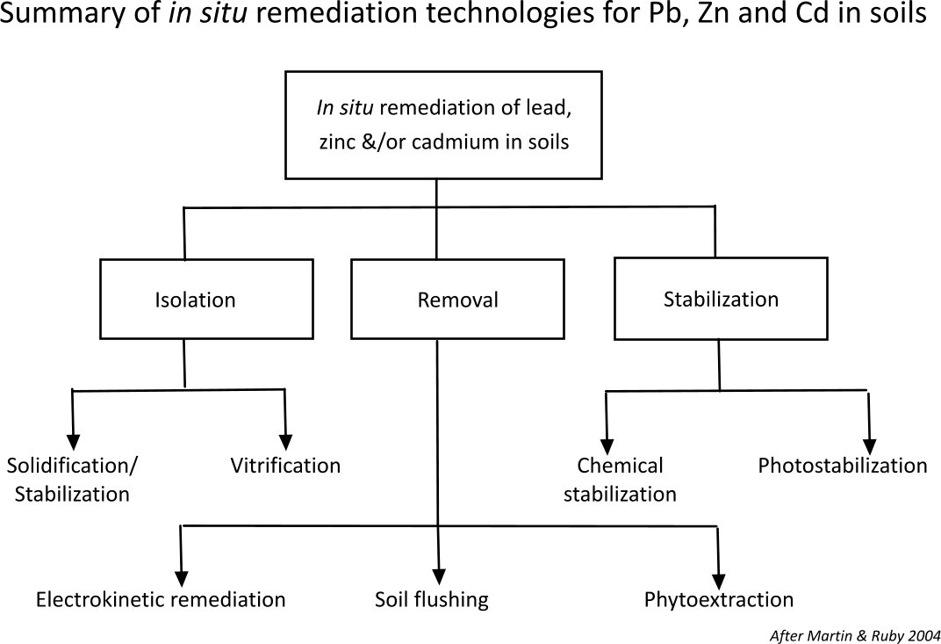
More than one way to solve a problem!
Ref: Review of in situ remediation technologies for lead, zinc, and cadmium in soil
Todd A. Martin & Michael V. Ruby (2004)

Slide 28
Other sources of information
USGS: Exploring contaminated land
https://www.usgs.gov/science-explorer-results?es=contaminated+land
US Environmental Protection Agency
https://www.epa.gov/environmental-topics
BGS: Engineering geology
https://www.bgs.ac.uk/research/engineeringGeology/home.html
International Information Centre for Geotechnical Engineers
https://www.geoengineer.org/education
Wikipedia: Brownfield land
https://en.wikipedia.org/wiki/Brownfield_land

