Slide 1
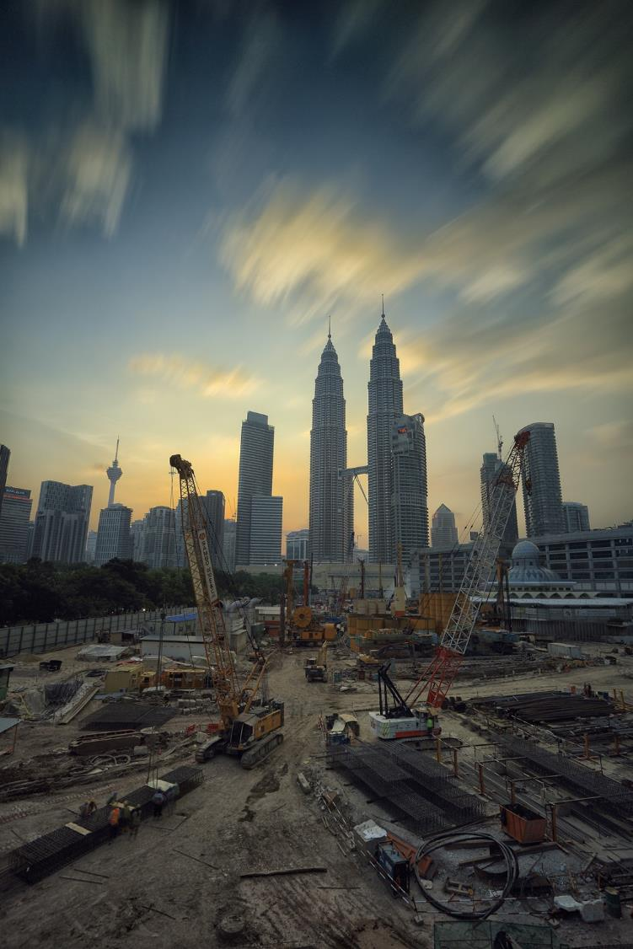
Remediation of industrial brownfield sites
Part 1: Problems
& hazards
Maggie Williams

Slide 2
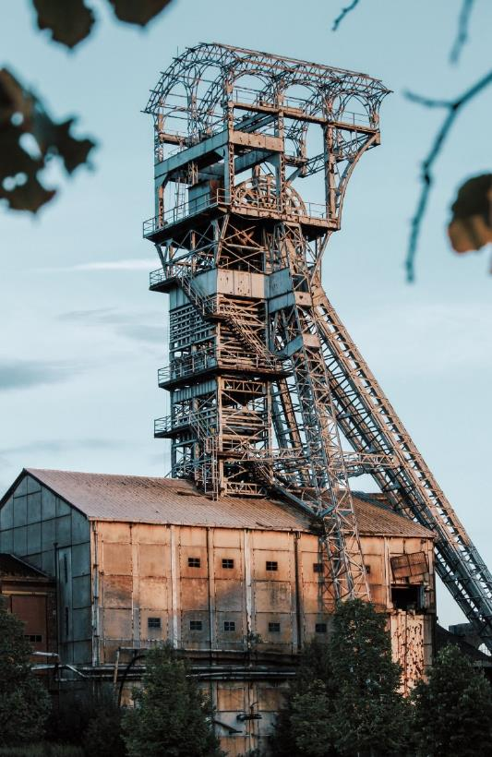
What is a brownfield site?
In the UK, a brownfield site is defined as a piece of "previously developed” land that has the potential for being redeveloped.
A brownfield site is often (but not always) land that:
has been used for industrial and commercial purposes
is now derelict
is possibly contaminated due to hazardous waste
may contain contaminants that cause harm to the environment &/or humans.
Notes:
In the USA a brownfield site is a piece of industrial land that has been abandoned and that is also contaminated with low levels of hazardous waste and pollutants.

Slide 3
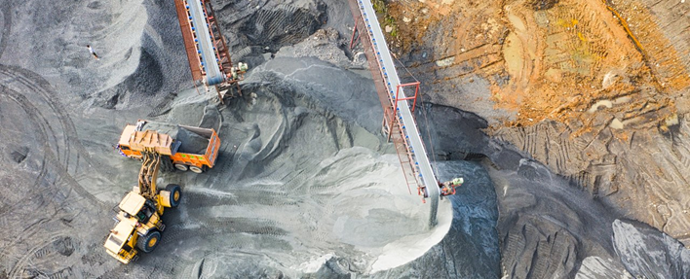
Why are brownfield sites important in the UK?
Approximately 3 million new homes will be required by 2030.
Building options - use brownfield sites or greenfield sites?
Lack of available green spaces for development, but over 66,000 hectares of brownfield sites in England. (N.B. 33% of these brownfield sites in the North & the Midlands, but most housing demand is in the S.E.)

Slide 4
Why are brownfield sites important in the UK?
Policies/statements
1998: UK Government set a national target for 60% of all new
developments to be built on brownfield sites.
2014: UK Government plans giving pre-planning approval for
housing on brownfield sites
2016: £1.2bn fund announced to prepare brownfield sites for
starter homes in the next 5 years
2017: brownfield registers compulsory for local authorities
2018: major overhaul to the National Planning Policy
Framework.
‘Although significant progress has been made, we must do more to deliver 300,000 homes a year by the mid-2020s.’

Slide 5
Brownfield sites
Often on disused or derelict land
More sites available in the North and Midlands
Sites already developed so reduces urban sprawl
Unsightly areas developed for building, so this improves the urban environment.
Existing buildings can be altered to create more homes on sites.
More expensive to build on because the land needs to be cleared first and the land may be contaminated.
Greenfield sites
Include the greenbelt land around cities
Sites which have not previously been built on
Are not favoured by environmentalists, as it encourages urban sprawl
Mean that countryside is built on and this damages the rural environment
People travel into urban areas so pollution and traffic congestion increase
Are cheaper to build on
n.b. Brownfield sites are considered for redevelopment of: housing and commercial buildings open spaces for recreation, conservation, woodland and other community areas.

Slide 6
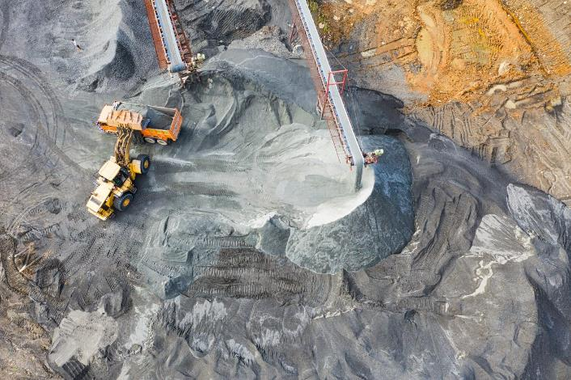
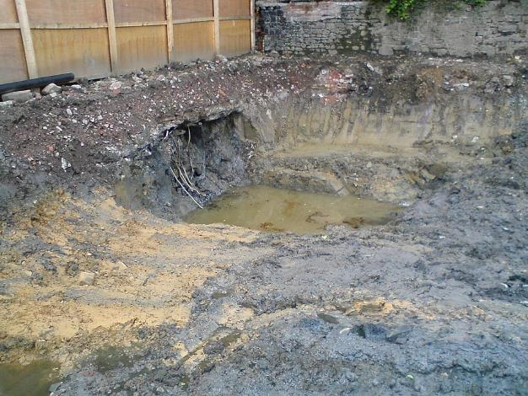
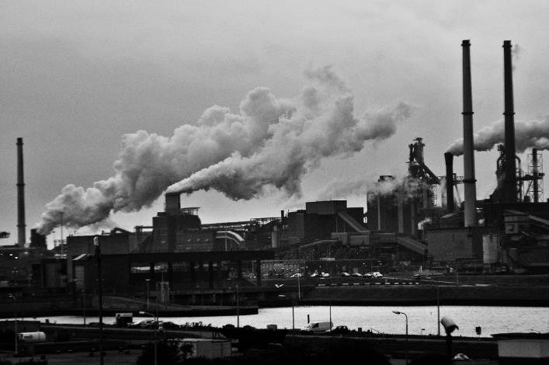
Main problems of industrial brownfield sites
Toxic chemical materials
Groundwater pollution
Ground instability
Subsidence
Credit: By Dumelow - Own work, CC BY-SA 4.0, https://commons.wikimedia.org/w/index.php?curid=3664752

Slide 7
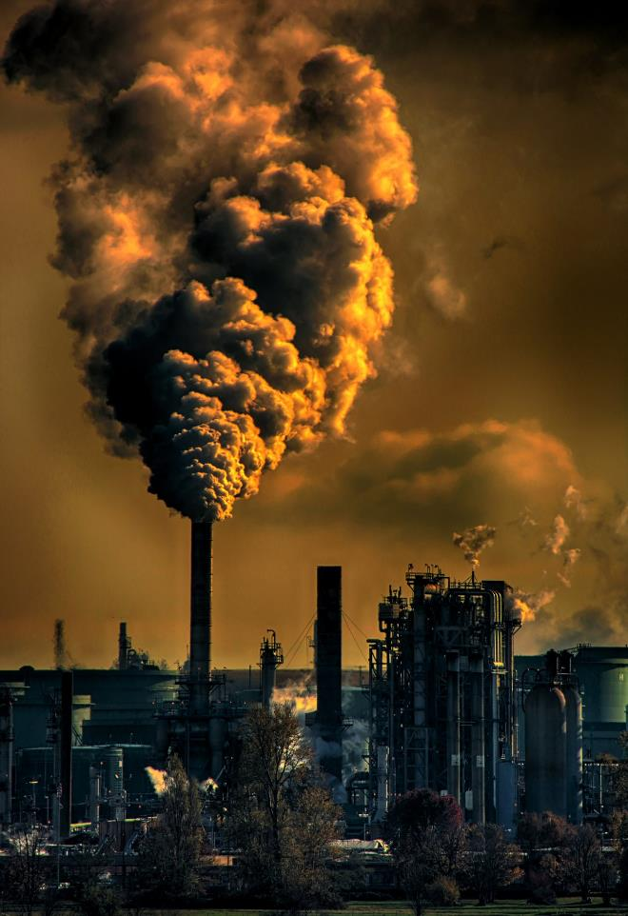
What is a contaminant?
A contaminant is a minor substance, material or agent that is unwanted in the environment and may or may not be harmful.
Contaminants can affect water, air and soil.
Contaminants are not necessarily pollutants.
A pollutant is a contaminant which, due to its properties or amount or concentration, causes harm to the environment &/or humans.

Slide 8
Possible sources of contamination
Type of industrial brownfield site | Possible source | Contaminant/ pollutant
Petrol station | Petrol | Hydrocarbons, benzene, toluene, xylene (BTX)
Commercial buildings, schools and houses | Heating oil | Hydrocarbons, benzene, toluene, xylene (BTX)
Dry cleaners | Cleaning solvents | Tetrachloroethylene, trichloroethane trichloroethylene (TCE),
Machine shops | Cleaning solvents, metal debris | Solvents e.g. Tetrachloroethylene, trichloroethylene, trichloroethane, Metals e.g. copper, nickel, iron, zinc, cadmium
Metal finishing/ plating shops | Plating solutions, cleaning solvents, acids & bases | Metals e.g. chromium, cadmium, tin, zinc, nickel, copper, lead Acids & bases e.g. sulphuric acid, nitric acid, hydrochloric acid, sodium hydroxide Solvents e.g. TCE
Landfills & dumps | Solvents, paints, batteries, metal parts | Almost anything

Slide 9
Benzene and benzene derivatives
Benzene
Increases the risk of cancer and other illnesses
Affects liver, kidney, lung, heart and the brain
A cause of bone marrow failure and abnormalities
Xylene
Causes loss of balance
Reduces coordination and reaction times
Irritates the skin & strips the skin of its oils
BTX (mixtures of benzene & toluene)
Toluene is much less toxic than benzene

Slide 10
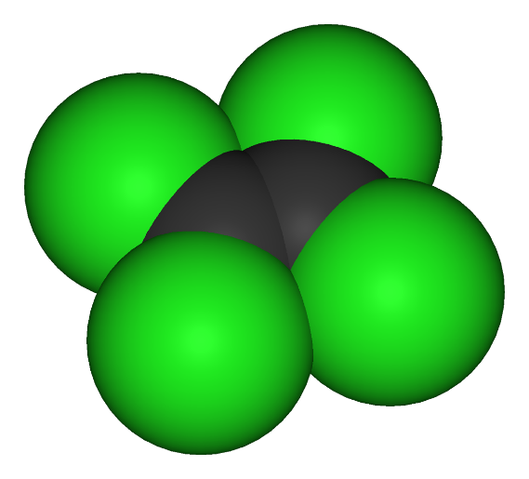
Trichloroethylene & tetrachloroethylene
Trichloroethylene (TCE)
Carcinogenic (risk of kidney cancer and liver cancer)
Toxic to the:
- central nervous system
- kidney & liver
- immune system
- male reproductive system
- developing foetus
Tetrachloroethylene
Credit: This file is licensed by under the
Creative Commons Attribution-Share Alike 3.0
Tetrachloroethylene (PCE)
Possibly carcinogenic
Affects nervous system and respiratory organs

Slide 11
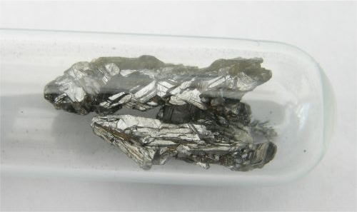
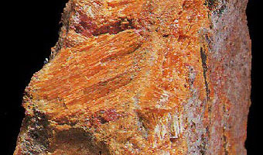
Arsenic
Classified as "toxic" and "dangerous for the environment" in the European Union
Carcinogenic (bladder & kidney cancer)
Causes arsenic poisoning
Bioaccumulative in many organisms (marine species in particular)
Realgar As₄S₄
Elemental arsenic
Credit: This file is licensed by under the
Creative Commons Attribution-Share Alike 3.0
Credit: This file is licensed by Tomihahndorf under the
Creative Commons Attribution-Share Alike 3.0
Notes:
Realgar As₄S₄ Bioaccumulation refers to the accumulation of substances, such as pesticides, or other chemicals in an organism.

Slide 12
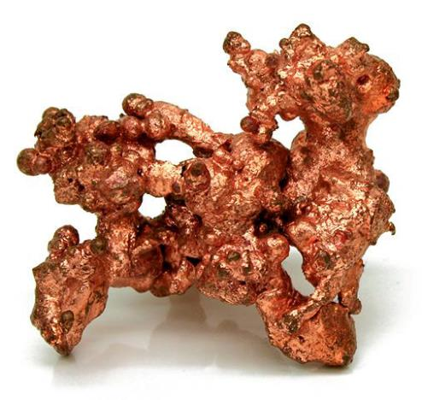
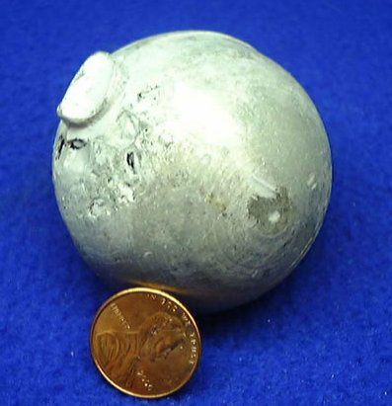
Copper
Cadmium
Neurotoxicity
Causes poisoning vomiting, hematemesis, low blood pressure, coma
Chronic exposure damages the liver & kidneys
Risk factor associated with kidney disease, early atherosclerosis,
hypertension and
cardiovascular diseases
Cadmium metal
Native copper
Credit: This file is licensed by Jonathan Zander under the Creative Commons Attribution-Share Alike 3.0
Credit: USGS
Notes:
Hematemesis (vomiting of blood), Neurotoxic (damages nervous system) Chronic (long term)

Slide 13
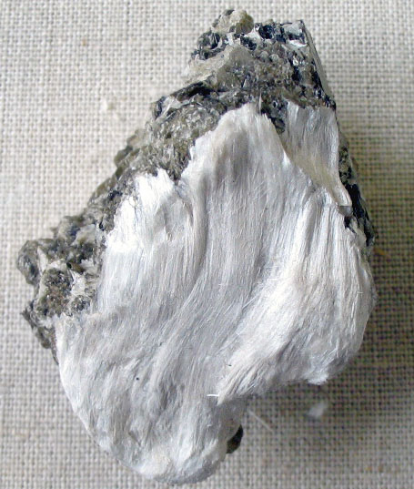
Asbestos
Asbestosis
Carcinogenic - causes malignant mesothelioma in humans
Fibrous tremolite asbestos on muscovite
Credit: This work has been released into the public domain by its author, Aramgutang at English Wikipedia

Slide 14
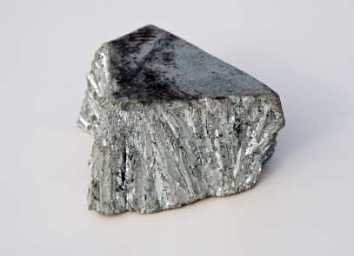
Zinc
Credit: https://nutrawiki.org/zinc/
Excessive intake of zinc reduces copper & iron absorption
Causes damage to nerve receptors in the nose
Risk of zinc poisoning (can be fatal)
> 500 ppm zinc in soil affects plant absorption of other essential metals e.g. iron and manganese
Free zinc ion in solution - highly toxic to plants, fish and invertebrates

Slide 15
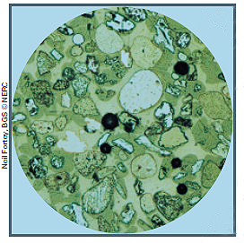
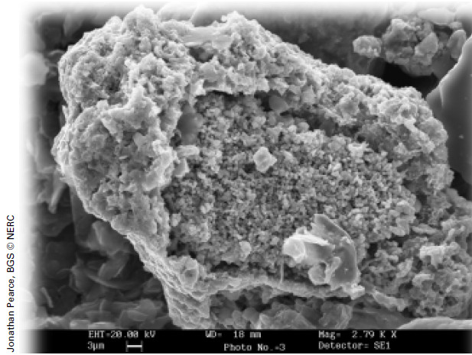
Heavy metals as residues
e.g. Metal shards in brownfield soil fragments
(Optical image of polished section. Field of view approximately 0.5mm across.)
e.g. Metallic slag particle from contaminated brownfield soil
(SEM image, approximately 85 microns across)
Ref: Heavy metals - contaminants under the microscope by Neil Fortey et al.
This Earthwise Magazine article (Earthwise Issue 17: Geology and health) maybe downloaded from: https://www.bgs.ac.uk/discoveringGeology/newsAndEvents/earthwise/downloadSearch.cfc?method=viewArticles

Slide 16
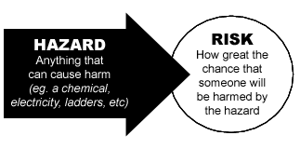
Hazards of heavy metals
Heavy metals may :
migrate into water supplies
be adsorbed from soil by being eaten
be absorbed from soil by being inhaled
Hazard is related to:
how metal-rich particles react in the human body
solubility of the metal
the way in which they occur
overall concentration of the metal

Slide 17
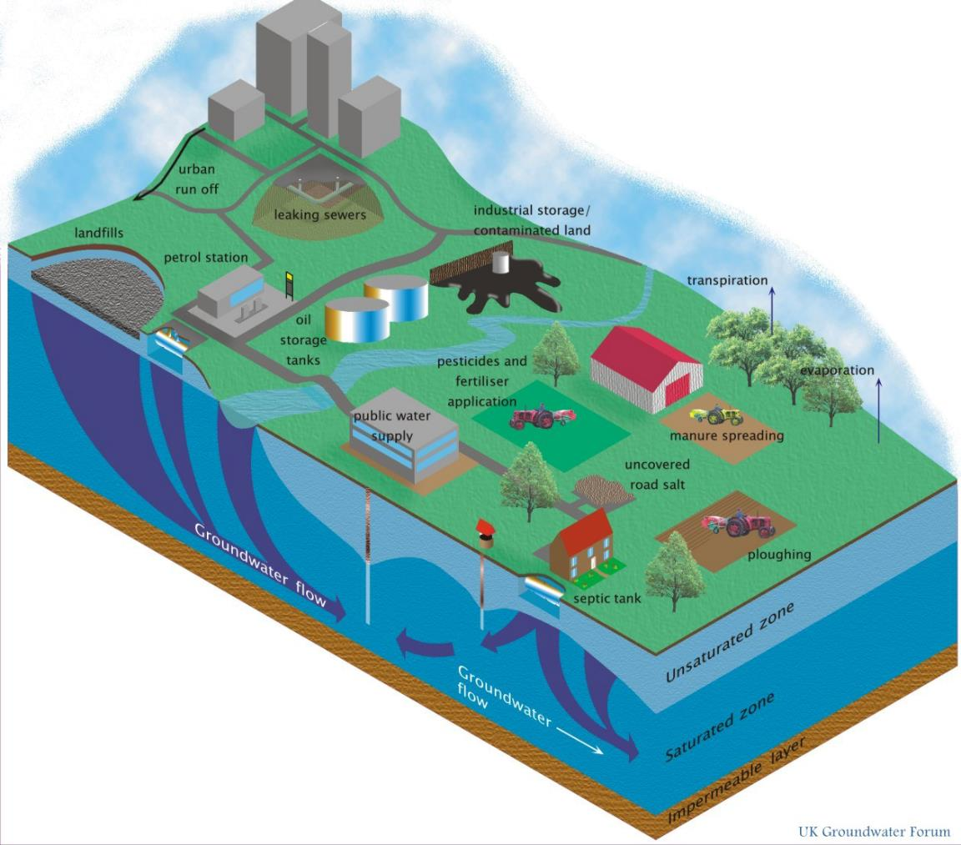
Hazards posing threats to quality of groundwater
N.B. Main sources
of pollution are from
industry, agriculture, domestic waste & urban areas
Notes:
Download the e-book 2nd edition of 'Groundwater - our hidden asset'

Slide 18
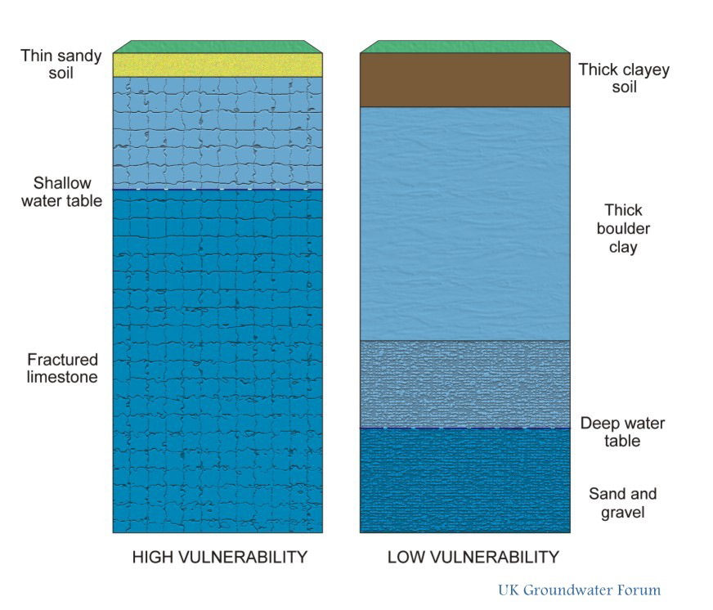
Why some aquifers are more vulnerable to contamination
Fractured limestones with a thin soil cover and a shallow water table are very vulnerable
Aquifers are least vulnerable where
there is:
- a thick cover of clay
- a thick unsaturated
zone
thick unsaturated zone

Slide 19
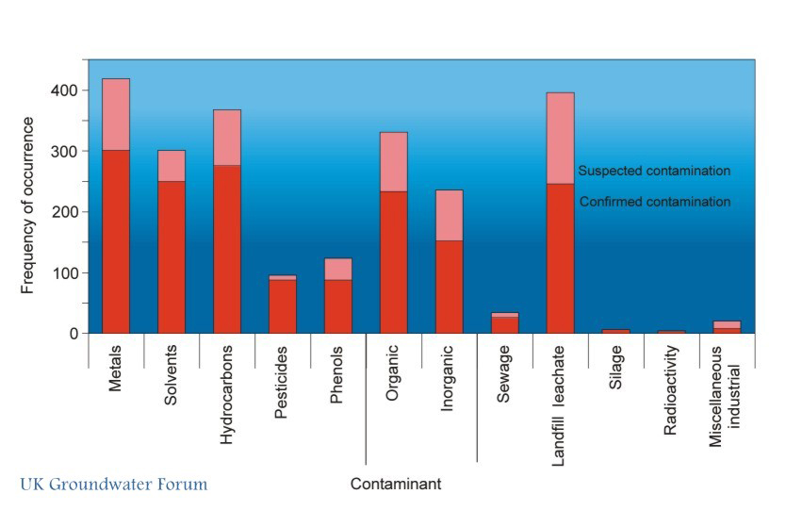
Frequency of contaminants in groundwater in England and Wales

Slide 20
Hazards of petroleum products, phenols and chlorinated hydrocarbons

Slide 21
Serious risk to groundwater quality from accidental spills and leaks of these substances from tanks and pipelines. Once an aquifer has been contaminated it is likely to remain so – remediation is very difficult to do.
WHO drinking water standard for benzene is 10μg/l.
Some of these substances are soluble in water. Others are only slightly soluble and called non-aqueous phase liquids (NAPLs).
Light NAPLs (mainly petroleum products) are less dense than water. Light NAPLs are more easily controlled - they float on the water table and occur at relatively shallow depths. | Dense NAPLs include the chlorinated hydrocarbons (materials widely used as industrial solvents) and are more dense than water. Dense NAPLs move under the influence of their density, can penetrate to considerable depths and are harder to control.

Slide 22
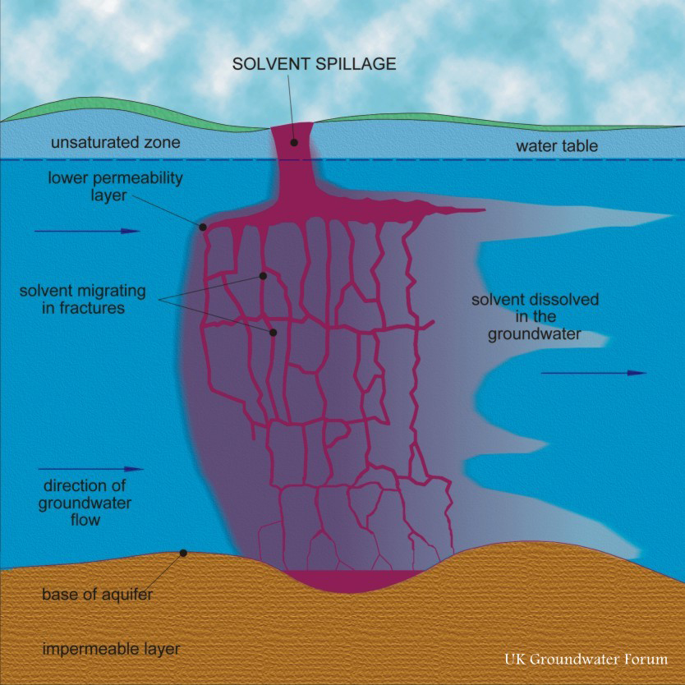
Hazard of spills & leaks from tanks, pipelines &
factory sites – the potential scale of the problem
A single spill may contaminate a very large volume of water
e.g. a spill of TCE (trichloroethylene) - a dense NAPL from a leather-processing factory in Cambridgeshire polluted the Chalk to a depth of 50m & extended for at least 2km in the direction of groundwater flow.
Pollution of the Chalk by the solvent tetrachloroethylene
Credit: www.groundwateruk.org/

Slide 23
Other sources of information
USGS: Exploring contaminated land
https://www.usgs.gov/science-explorer-results?es=contaminated+land
US Environmental Protection Agency
https://www.epa.gov/environmental-topics
BGS: Engineering geology
https://www.bgs.ac.uk/research/engineeringGeology/home.html
International Information Centre for Geotechnical Engineers
https://www.geoengineer.org/education
Wikipedia: Brownfield land
https://en.wikipedia.org/wiki/Brownfield_land

